Slide 1


Romantic Chaos – A study of the emergence of unpredictability in relationships
Sándor Battaglini-Fischer, Yehui He, Thomas Norton, Victor Piaskowski

Slide 2
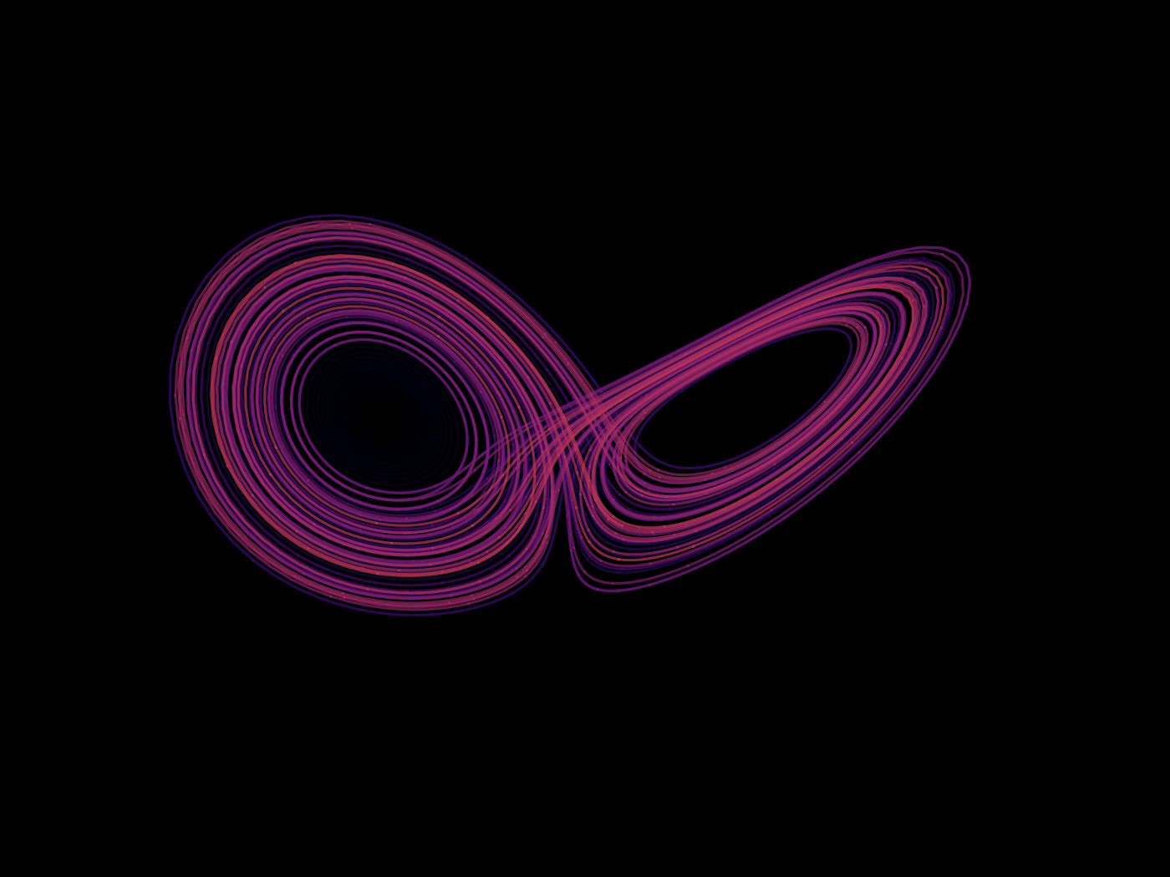
Background/Motivation
Research question: Under what conditions does complexity emerge in romantic relationships?
Chaos: “When the present determines the future, but the approximate present does not approximately determine the future”.
it must be sensitive to initial conditions,
it must be topologically transitive,
it must have dense periodic orbits
Hypothesis: Romantic complexity requires:
A particular set of character traits (parameters) – insecurity, wrong expectations
External influences (environmental noise or inspiration term)
Third parties displaying interest in one of the partners (Higher dimensional dynamical system, network model)
Lorenz, E. N. (1993). The Essence of Chaos
Notes:
Sensitive to Initial Conditions: “Butterfly effect," small changes in the initial conditions can lead to vastly different outcomes. In a chaotic system, two nearly identical states can evolve into two completely different states over time. This sensitivity makes long-term prediction impossible in practice, even if the system is deterministic in theory.
Topologically Transitive: It cannot be broken down or decomposed into two subsystems (two invariant open subsets) which do not interact because of topological transitivity
Dense periodic orbits: Amid the “random” behaviour, we nevertheless have an element of regularity, namely the periodic points, which are dense.

Slide 3

Outline
Base Model and Assumptions
Emergence of Chaos through Environmental Influence
Environmental Stress
Extra Emotional Dimensions
Unpredictability in triangular relationships
Love as a 6D dynamical system
Reduction to a 4D dynamical system and a basic network model

Slide 4
Base Model and Assumptions
Rinaldi, S., Rossa, F. D., Dercole, F., Gragnani, A., & Landi, P. (2015). Modeling Love Dynamics: Vol. Volume 89. WORLD SCIENTIFIC. https://doi.org/10.1142/9656

Slide 5


Base Model and Assumptions
Synergic
Platonic
Secure
Insecure
Biased
Unbiased
Rinaldi, S., Rossa, F. D., Dercole, F., Gragnani, A., & Landi, P. (2015). Modeling Love Dynamics: Vol. Volume 89. WORLD SCIENTIFIC. https://doi.org/10.1142/9656

Slide 6
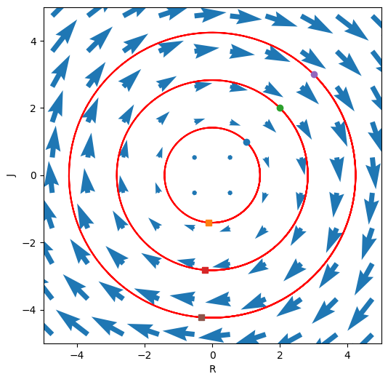
Example: Love Dynamics of a couple
Romeo: Synergic lover
Juliet: Insecure lover
Strogatz S. (1988). Love Affairs and Differential Equations, Mathematics Magazine Volume 61
Notes:
One of the basic situation. Both feelings only affected by the other not by themselves. Romeo Synergic, Juliet Insecure.
The sad outcome of their affair is, of course, a never-ending cycle of love and hate; the governing system has a center at ( R, J ) = (0, 0). At least they
manage to achieve simultaneous love one-quarter of the time

Slide 7
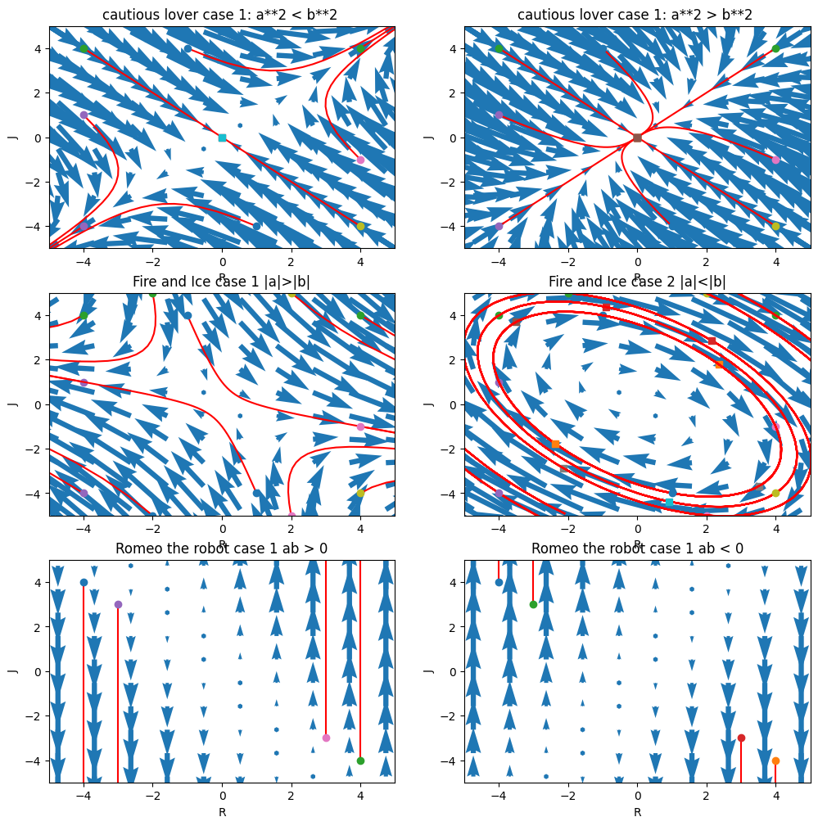
Different cases
Identically insecure lovers
Fire and Ice (Do opposites attract?)
Romeo the Robot
Notes:
Each case has two different outcome. Determined by parameters, eigenvalue and corresponding eigenvector will reveal the behaviour of the system.
Identically insecure lovers
If a2 > b2, the relationship always fizzles out to mutual indifference. The lesson
seems to be that excessive caution can lead to apathy.
If a2 < b2, the lovers are more daring, or perhaps more sensitive to each other.
Now the relationship is explosive. Depending on their feelings initially, their relationship
either becomes a love fest or a war. In either case, all trajectories approach
the line R = J , so their feelings are eventually mutual.
2. FIRE AND ICE
The outcome depends on whether the individuals respond more to themselves (|a| > |b|) or to the other (|a| < |b|). The former case leads to a saddle in which the eager beaver and hermit are at odds and the narcissistic nerd and cautious lover are in love or at war, and the latter leads to a center. Thus they can end up in any quadrant (all four combinations of love and hate) or in a never-ending cycle, but never apathetic.

Slide 8

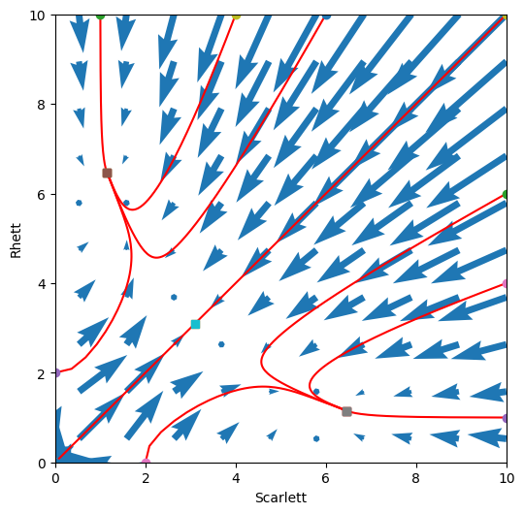

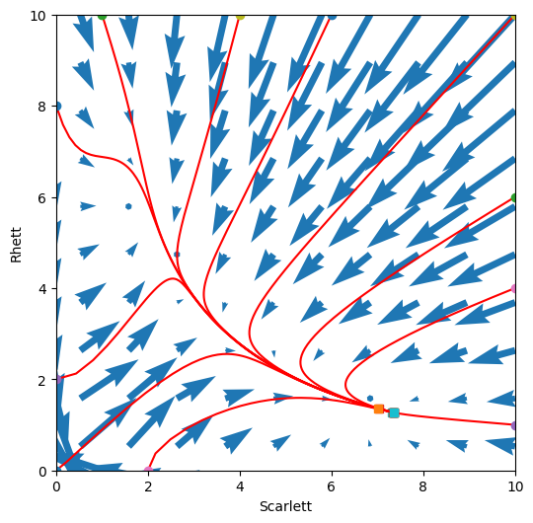
Nonlinear dynamics example: “Gone with the Wind” (1939)
Both are insecure type
Rinaldi, S., Della Rossa, F., & Landi, P. (2013). A mathematical model of “Gone with the Wind”. Physica A, 392, 3231–3239. doi: 10.1016/j.physa.2013.03.034
Notes:
Both insecure lovers. Same type
First, it is a positive model. trajectories in state space cannot leave the positive quadrant
Second, the divergence of the model, which is −2, does not change sign so that, in view of Bendixon’s (Dulac) criterion, the model cannot have limit cycles, i.e. the feelings of Scarlett and Rhett cannot oscillate periodically.
In conclusion, for any given initial condition in the first quadrant, the model can only evolve toward an equilibrium point, i.e. if all parameters remain unchanged Scarlett and Rhett must tend toward a stationary relationship.
The mathematical model of couples of this kind predicts that the love story tends toward a stationary regime in which the involvement of the two partners can be quite unbalanced.
More precisely, we show that in the long run the individual who is less involved is the most appealing one. This is why the end of “Gone with the Wind”, where Rhett quits Scarlett after a long relationship, can be perfectly predicted.

Slide 9

Notes:
More precisely, we show that in the long run the individual who is less involved is the most appealing one. This is why the end of “Gone with the Wind”, where Rhett quits Scarlett after a long relationship, can be perfectly predicted.

Slide 10
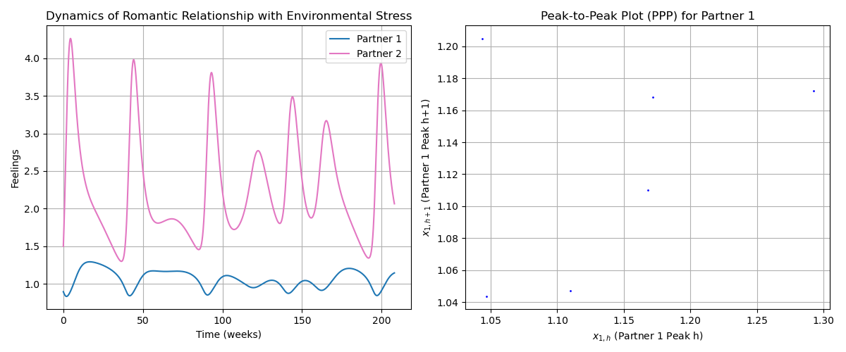
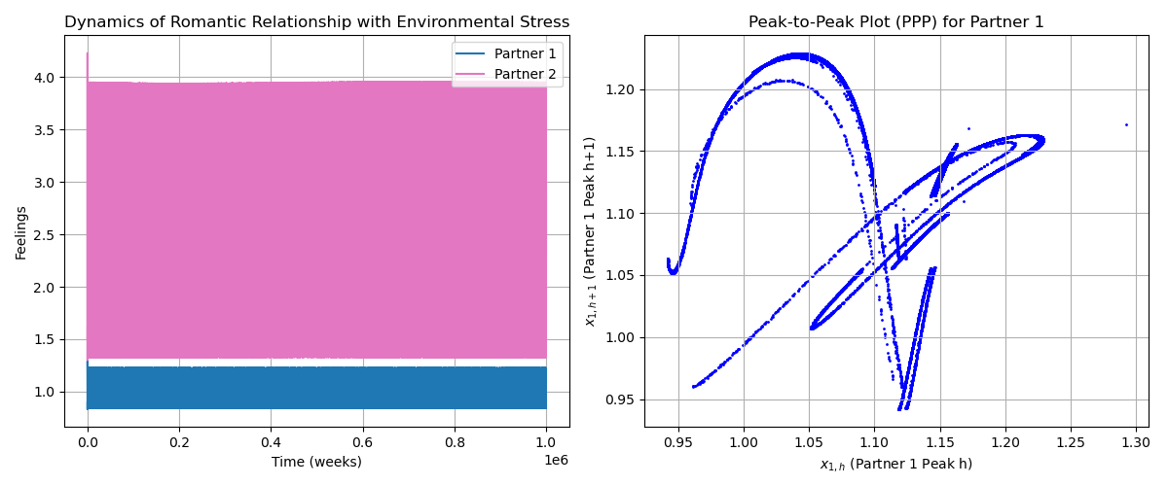
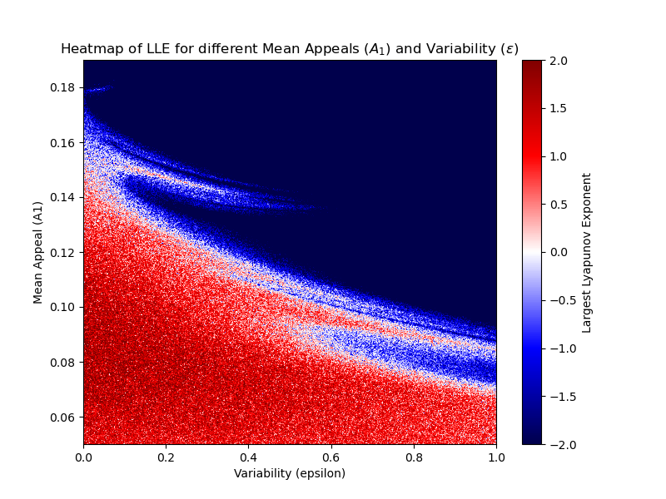
Environmental stress
Non-chaotic
Chaotic
Rinaldi, S., Rossa, F. D., Dercole, F., Gragnani, A., & Landi, P. (2015). Modeling Love Dynamics: Vol. Volume 89. WORLD SCIENTIFIC. https://doi.org/10.1142/9656
Notes:
This model was taken from the book "Modeling Love Dynamics", and adds another factor called environmental stress. Couples can experience highs and lows from various different factors, and in this example, the appeal of one individual changes over time. For example, perhaps over a year or longer time period the appeal of a person can vary from factors like work stress.
As can be seen in the left diagram, the feelings over time of both partners is very irregular, with peaks at different heights and intervals. This can be seen in the peak to peak plot, where each peak is plot against the previous peak. If the behaviour was periodic, we would see just one or a few points. This is not the case, indicating chaotic behaviour.
To further quantify this, the largest lyapunov exponent was calculated for the mean appeal against the variability. Blue represents a negative LLE, indicating stationary regimes; white represents an LLE of 0, indicating periodic regimes; and red represents a positive LLE, indicating chaotic regimes.
------------
Additional notes:
One simple test is called the peak to peak plot. This is constructed by extracting the peaks from each long time series and plotting them against the previous one. If the plot contains just
A very simple test consists of extracting from each long time series the peaks xh1 , h = 1, 2, 3, . . . and in plotting them one versus the previous one. The result is the so-called peak- to-peak plot (PPP). Thus, if the PPP contains only one point (or a few points) the time series is periodic. In contrast, if the points of the PPP are densely distributed on a regular closed curve (the section of a torus) the time series is quasi-periodic, while if the PPP is a fractal set the time series is chaotic.
The sign of the largest Lyapunov exponent (LLE) identifies the nature of the attractor: strange attractors (chaotic regimes) have positive LLEs, stable cycles and tori (periodic and quasi-periodic regimes) have LLEs of 0, and stable equilibria (stationary regimes) have negative LLEs.

Slide 11
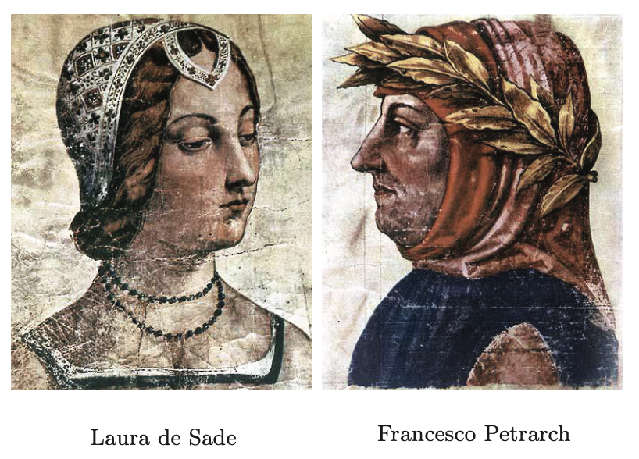
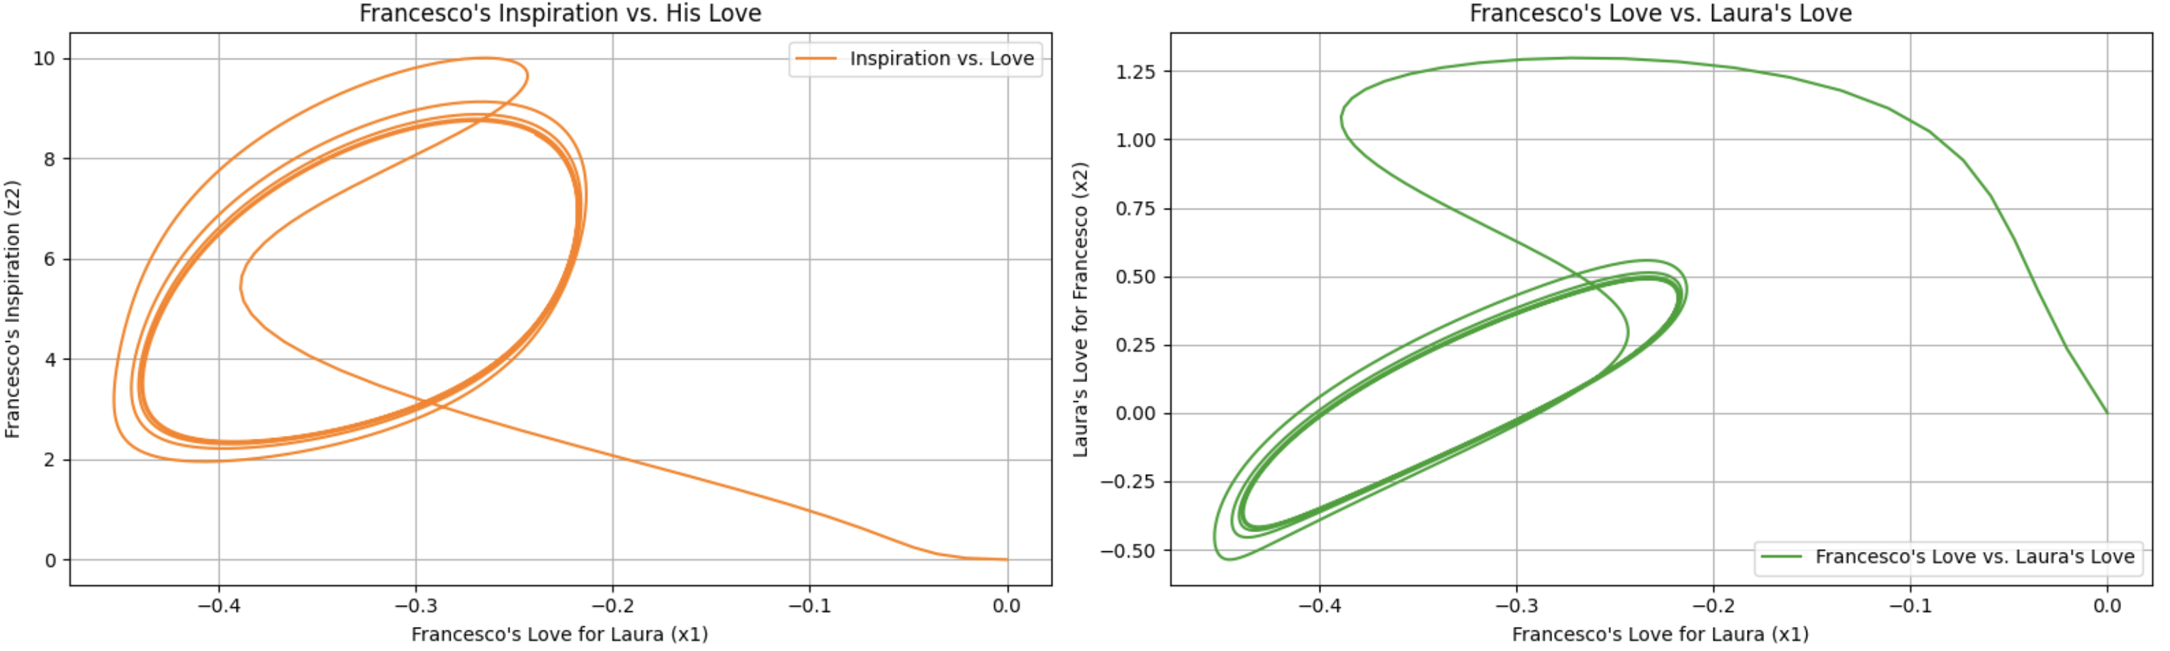
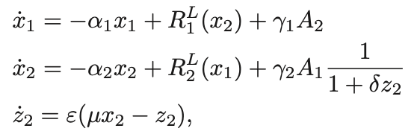
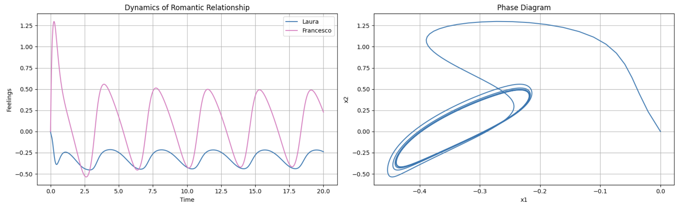
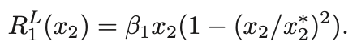
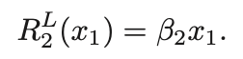
External inspiration
Rinaldi, S., Rossa, F. D., Dercole, F., Gragnani, A., & Landi, P. (2015). Modeling Love Dynamics: Vol. Volume 89. WORLD SCIENTIFIC. https://doi.org/10.1142/9656
Notes:
Now the next model we will take a look at is based on the story of Laura and Francesco. Laura and Francesco were real people in the 1300s, who met when Laura was married and Francesco was just 23 years old. He then spent the next 21 years writing over 200 poems to her, leading him to be known as one of the most lovesick poets of all time.
This model was also taken from the same book as the last, and the authors based it off of research they did on the date and content of his poems. This model introduces a new emotional dimension, inspiration. Only Francesco possesses this dimension, which influences their relationship.
The existence of multiple dimensions typically has a destabilising effect, leading to romantic chaos, but as seen here this is not the case. After an initial spike, the feelings of both individuals stabilises, leading to periodic behaviour.

Slide 12
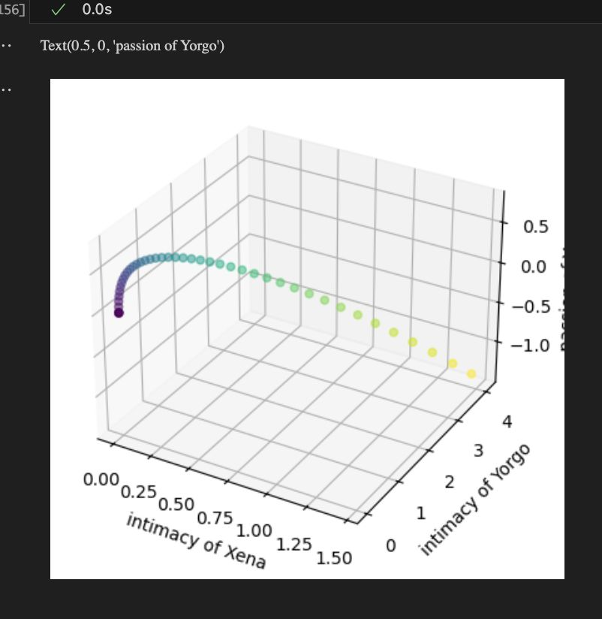
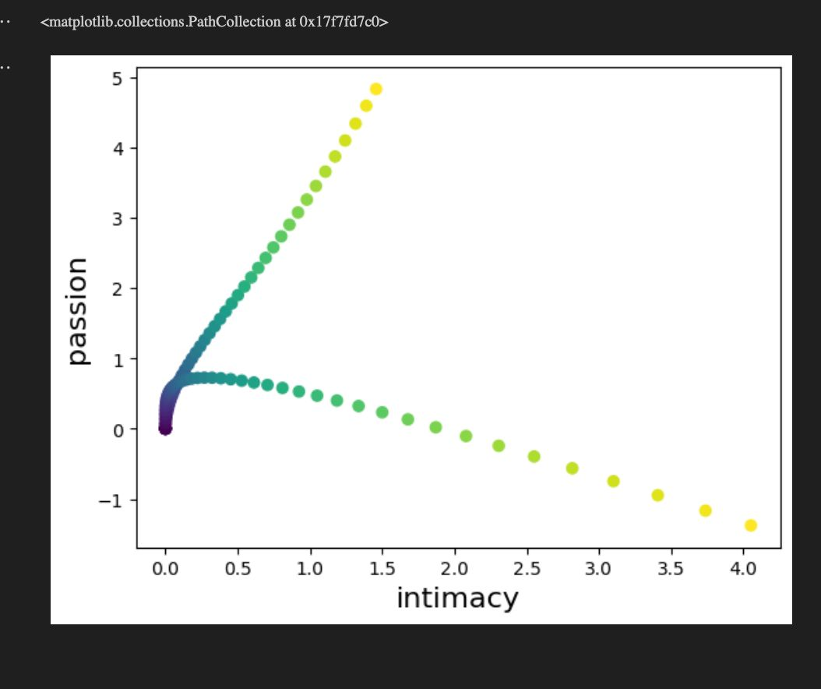
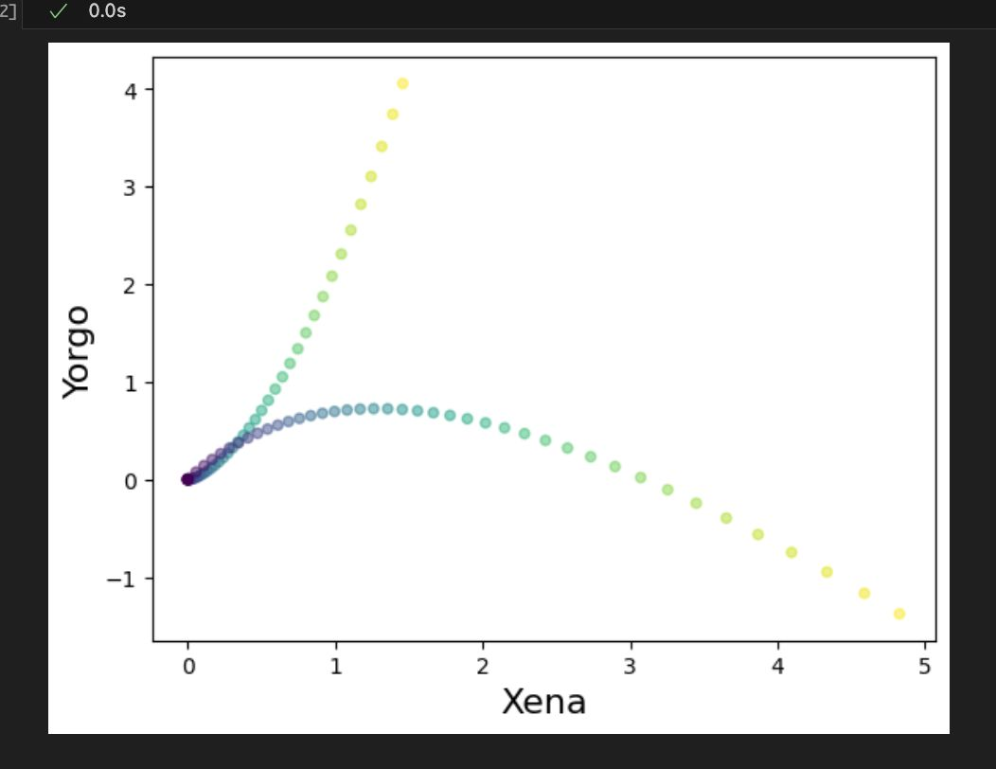
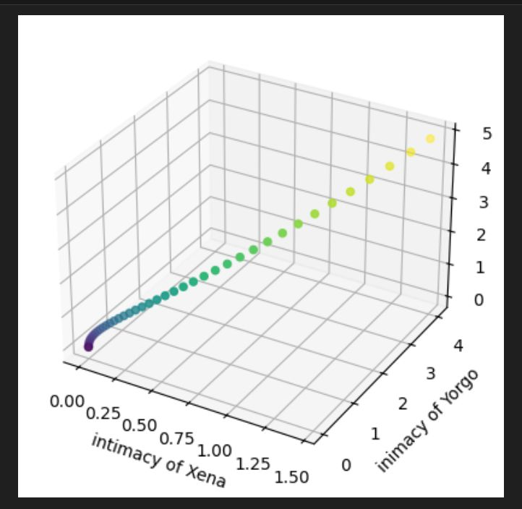
Love as a 4D Dynamical System

Slide 13
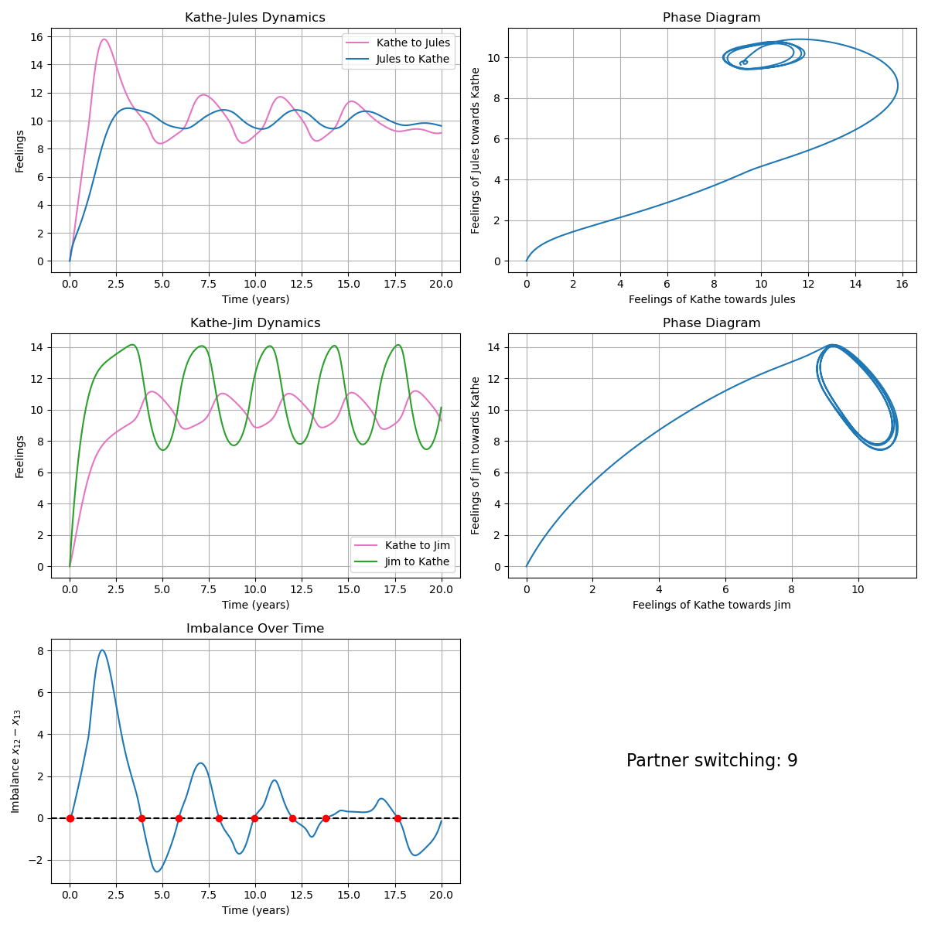
Triangular Relationships (1/3)
Kathe
Jules
Jim
“Jules et Jim” - Henri-Pierre Roché (1953) “Jules & Jim” - François Truffaut (1962)
Partner changes: 7
Rinaldi, S., Rossa, F. D., Dercole, F., Gragnani, A., & Landi, P. (2015). Modeling Love Dynamics: Vol. Volume 89. WORLD SCIENTIFIC. https://doi.org/10.1142/9656
Notes:
Triangular Relationships
Common in couples (60% of Americans), known to introduce unpredictability. Different types, from “Ménages à Trois” to a fixed couple and a jealous lover. The unpredictability is a source of pain for one individual and causes stress.
“Jules et Jim” – Henri Pierre Roché
Based on the concept of ”Free Love” (Big thing in the Hippies 60’s and 70’s, Bertrand Russel) where we “should not try to possess or constrain the people we love, but leave them free to engage in other relationships”. This allows us to:
split Kathe into two independent persons, no particular internal conflict
2 separate couples, with a coupling constant
Friendship between Jules and Jim
Traits
Kathe: insecure (react negatively to the platonic nature of Jules) and synergic (the more she is in love, the more appealing she finds her partner)
Jules: secure and platonic (the more he is in love, the less reacts to Kathes appeal) -> he likes when she’s with Jim
Kathe: secure and synergic
Jim: insecure and unbiased
Equations:
We add small coupling parameters: an internal conflict parameter epsilon to Kathe, Jealousy/Complaisance delta
Kathe S synergism term, Jules P platonicity term
Time period: 20 years
What can we see from the graphs:
She’s more interested in Jules at the start, but Jim’s love affects her more
Jim’s ups and down’s are more severe and affect Kathe more
The drops in Kathe for Jules anticipate those of Jules for Kathe, and Jim-Kathe. Kathe (1) and Jim (2) insecure.
From this we can calculate the Imbalance in feelings, to see towards which partner she tends more -> calculate partner switching.
9 here, 7 in book.

Slide 14
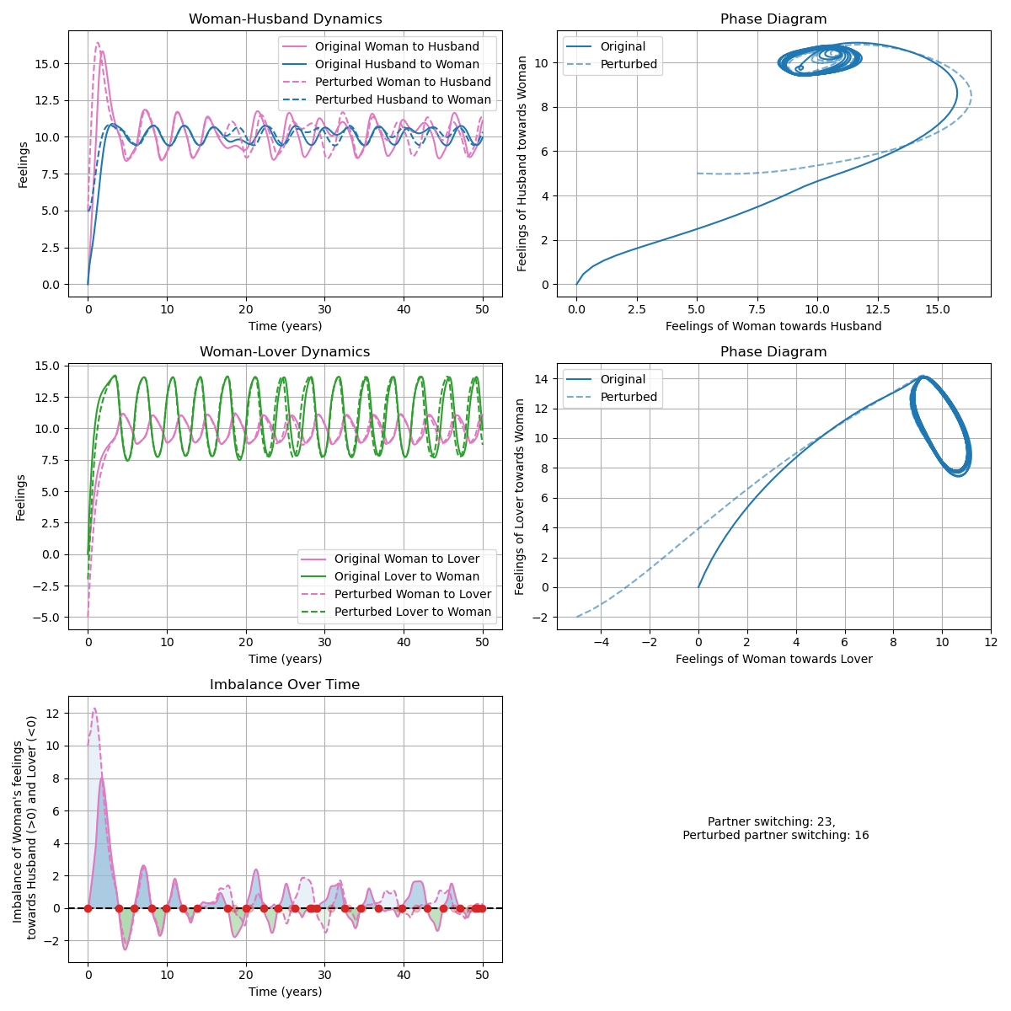
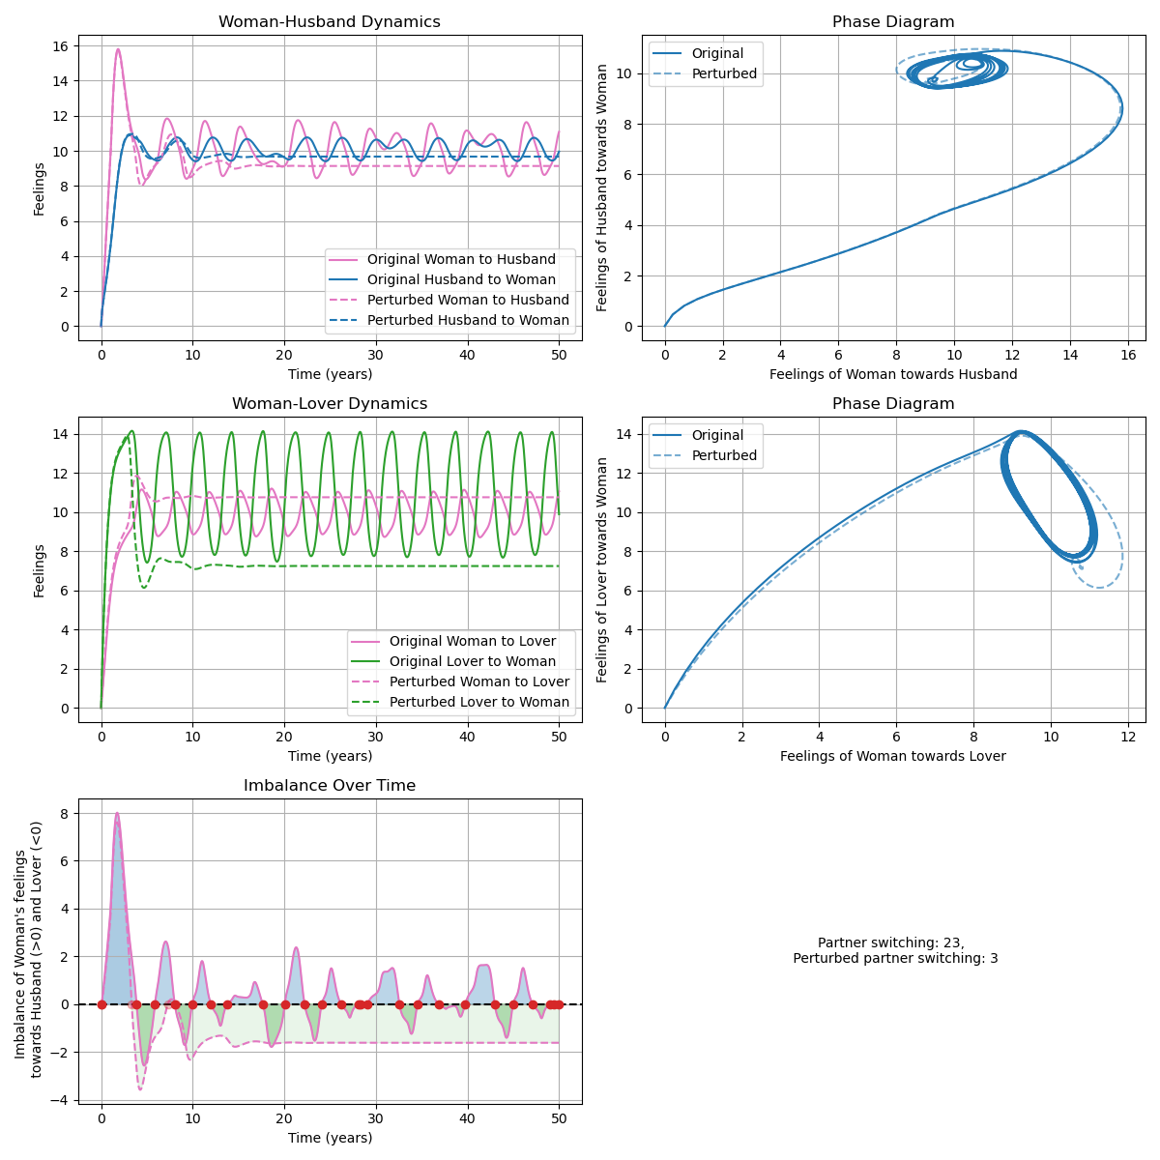
Triangular Relationships (2/3)
Result:
The outcome doesn’t depend on the initial conditions (feelings),
but much more on the intrinsic characteristics of the partners!
Perturbed initial conditions:
+5 initial feelings for Husband,
-5 initial feelings for Lover
Perturbed parameter:
Jim’s appeal increases by 10%
Rinaldi, S., Rossa, F. D., Dercole, F., Gragnani, A., & Landi, P. (2015). Modeling Love Dynamics: Vol. Volume 89. WORLD SCIENTIFIC. https://doi.org/10.1142/9656
Notes:
Want to know more about the complex nature of the system.
Initial Conditions perturbed: Much larger initial feelings towards Jules, adversion between Kathe and Jim
=> Not a big difference in dynamics
Parameters perturbed: Slightly more (10%) appeal of Jim
=> largely different dynamics, leads to fixed points
Conclusion:
This triangular relationship works, but very fragile, and only because the individuals have the characteristics they have
The outcome doesn’t depend on the initial conditions (feelings), but much more on the intrinsic characteristics of the partners!

Slide 15
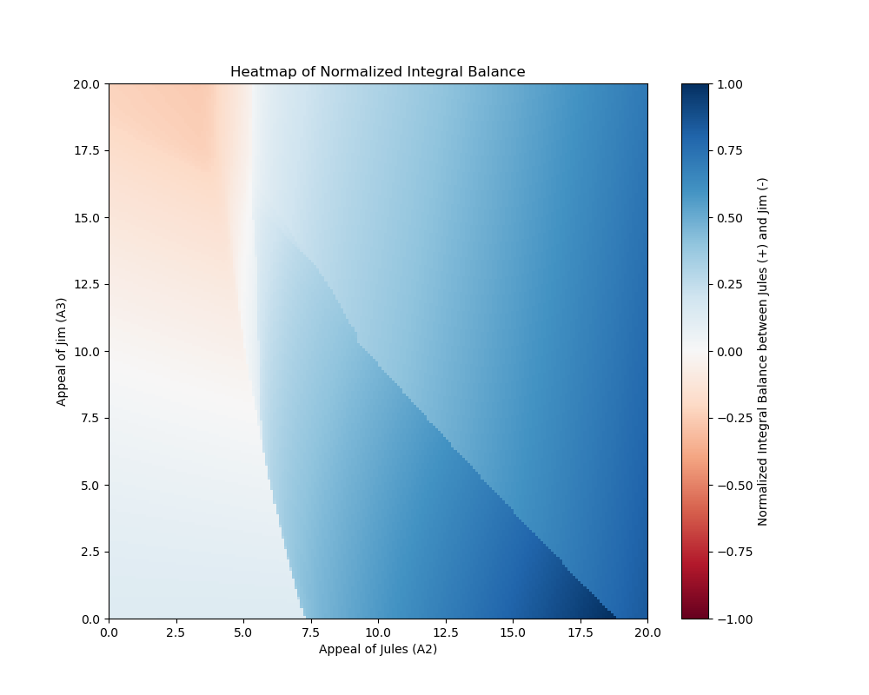
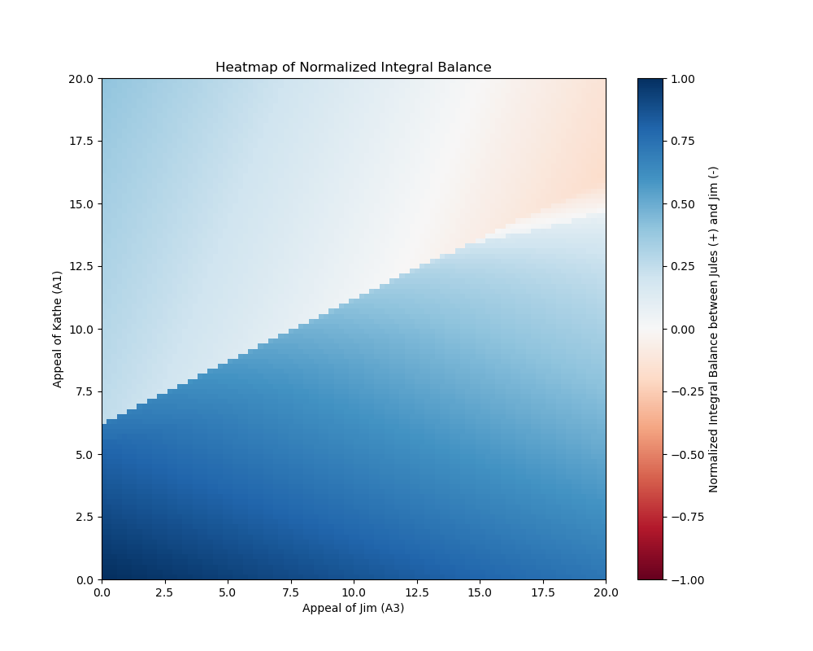
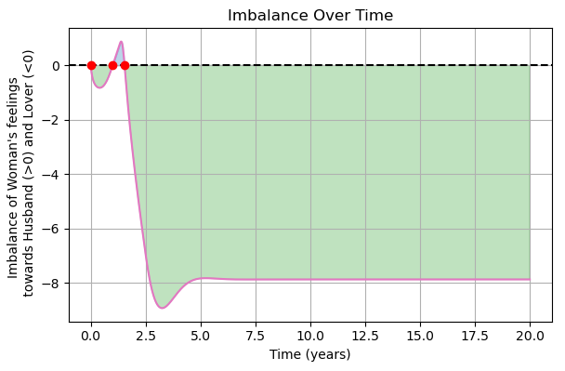
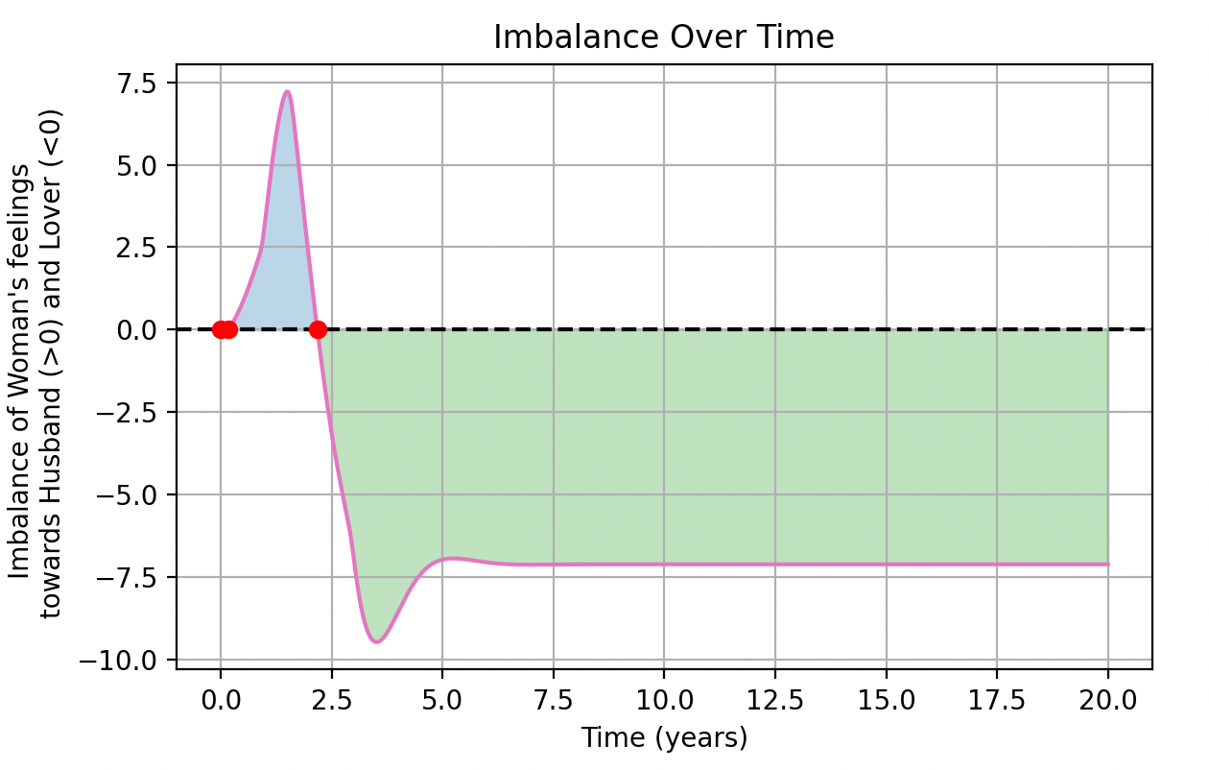
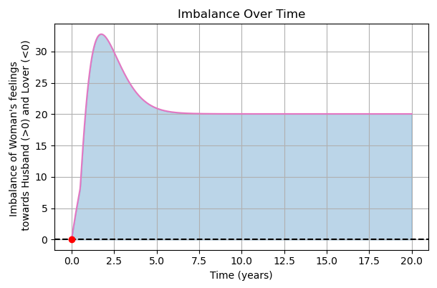
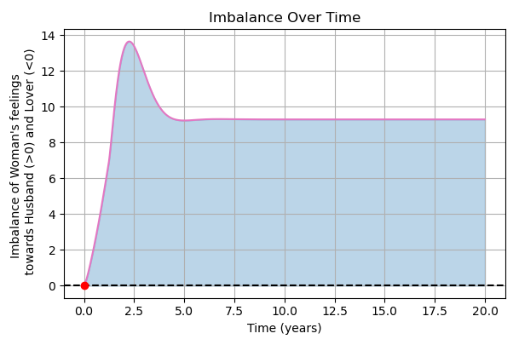
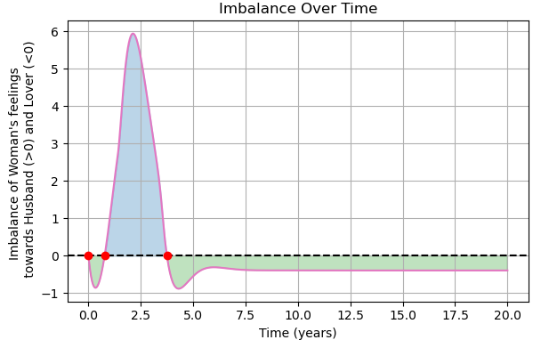
Triangular Relationships (3/3)
Rinaldi, S., Rossa, F. D., Dercole, F., Gragnani, A., & Landi, P. (2015). Modeling Love Dynamics: Vol. Volume 89. WORLD SCIENTIFIC. https://doi.org/10.1142/9656
Notes:
To analyse the sensitivity in parameter space:
Sensitivity analysis, by calculating the LLE, and sorting by the positive (chaotic) ones, and then seeing which ones are more sensitive to creating “chaotic” conditions.
Results: the appeal of the individuals has the most effect, so we vary this and calculate the ”Normalised Integral Balance”.
Qualitative change in behaviour due to small changes-> phase transition-like behaviour
Order parameter: Integral balance
Conclusion: Sometimes a small step up in appeal will create a big difference! ☺

Slide 16
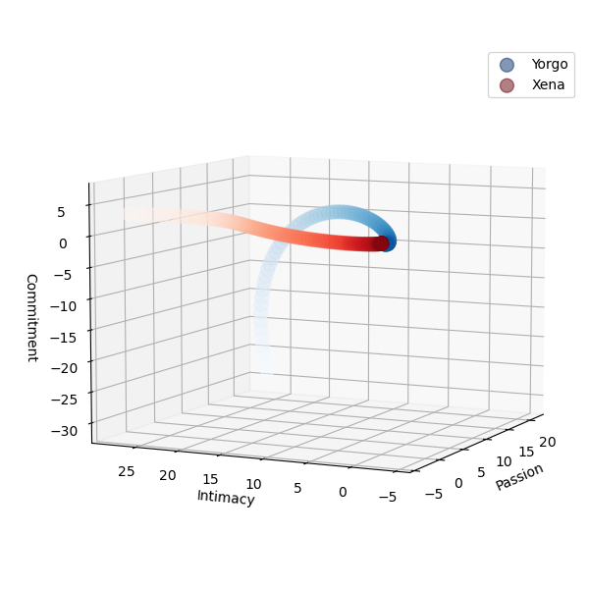
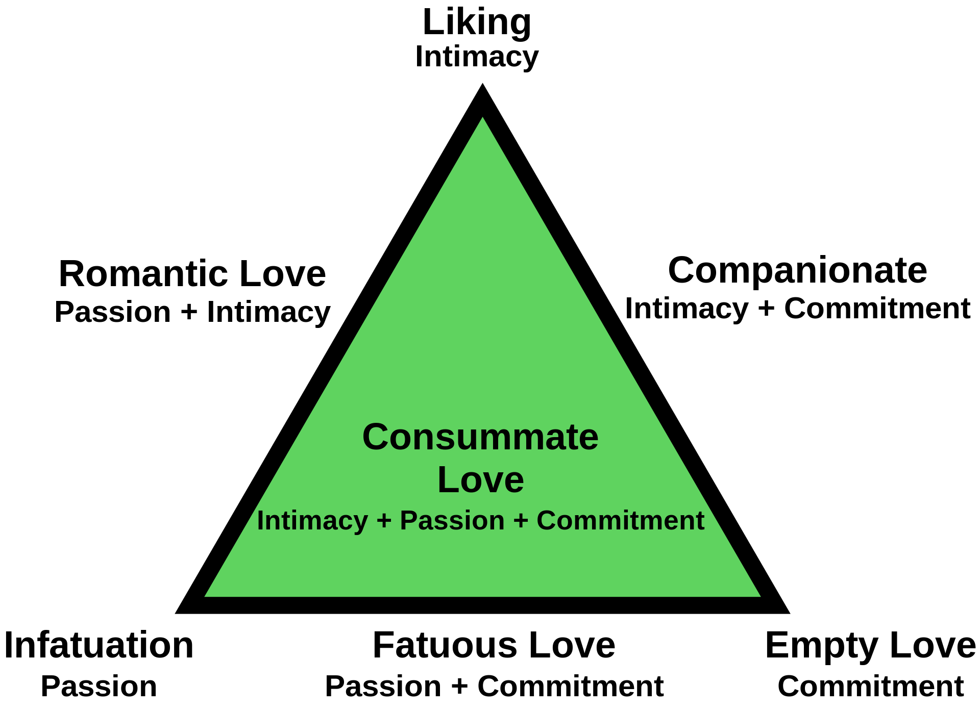
Love as a 6D dynamical system - Sternberg’s “Triangular Theory of Love”
Sternberg, R. J. (1986). A triangular theory of love. Psychological Review, 93(2), 119–135. https://doi.org/10.1037/0033-295X.93.2.119
ERBAŞ, K. C. (2022). Modeling Love with 4D Dynamical System. Chaos Theory and Applications, 4(3), 135-143. https://doi.org/10.51537/chaos.1131966
Notes:
American psychologist Robert Sternberg (1986):
3 Dimensions -> 7 Types of “Love”
Intimacy: emotions that lead to the experience of warmth in a loving relationship
Passion: emotions that lead to sexual attraction and romance
Commitment: conscious decision to stick with one another
Based on this, we developed a 6D dynamical system of linear ODEs. The (normalised) coefficient matrix determine the amount of influence of the variables to each other. (-1. 1) for simplicity
For example, d_xy is xenas passion as a function of yorgo’s passion, if he’s passionate in one moment, she’ll be more passionate in the next (if the coefficient is positive).
These are held in check by other terms, for example it could freak her out if the relationship get’s to committed.
In this vastly simplified model, the goal is to maximise the three variables for each partner, so they each land in a positive regime. Then, according to Sternberg, we have “Consummate Love”, the highest form.
There is a psychologically established relationship between intimacy and passion, whereas the influence of commitment has not yet been conclusively studied.
Baumeister, R. F., & Bratslavsky, E. (1999). Passion, intimacy, and time: Passionate love as a function of change in intimacy. Personality and Social Psychology Review, 3(1), 49–67. https://doi.org/10.1207/s15327957pspr0301_3
Aykuto ̆glu B and Uysal A (2017) The Relationship between Intimacy Change and Passion: A Dyadic Diary Study. Front. Psychol. 8:2257.

Slide 17
Reduction to a 4D Dynamical System – Network Model
Omission of the commitment dimension for simplicity
Small fully connected network (n=10, n(n-1)/2 = 45 number of edges!)
Everyone knows (and is "in love" with) one another
Option to have everyone aware of each other's parameters (normalizing parameters) -> small changes in network cause other people to adapt how they perceive other people
ERBAŞ, Kadir Can. “Modeling Love with 4D Dynamical System.” Chaos Theory and Applications, vol. 4, no. 3, Akif Akgul, 30 Nov. 2022, pp. 135–143. doi:10.51537/chaos.1131966.
Notes:
We reduce to a 4D system, expanding to a network model from Erbas

Slide 18
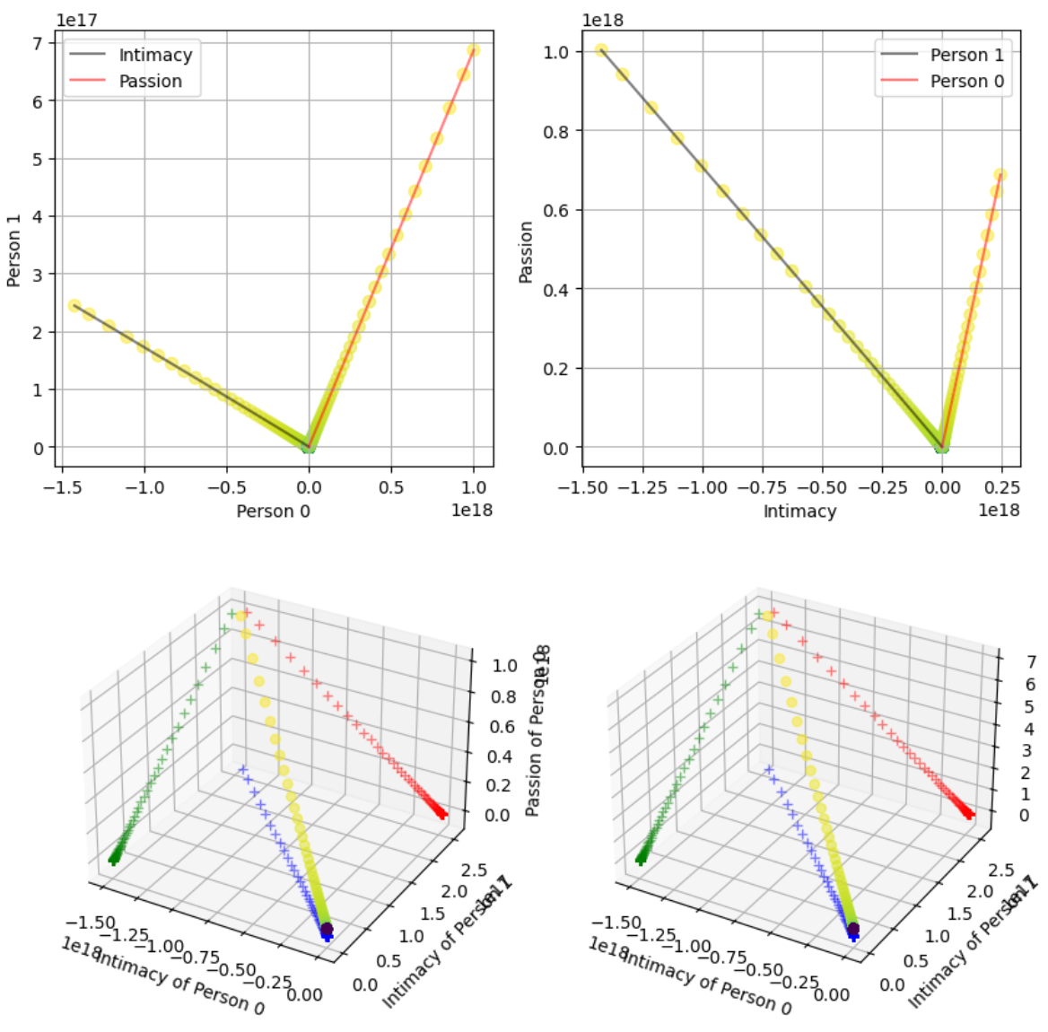
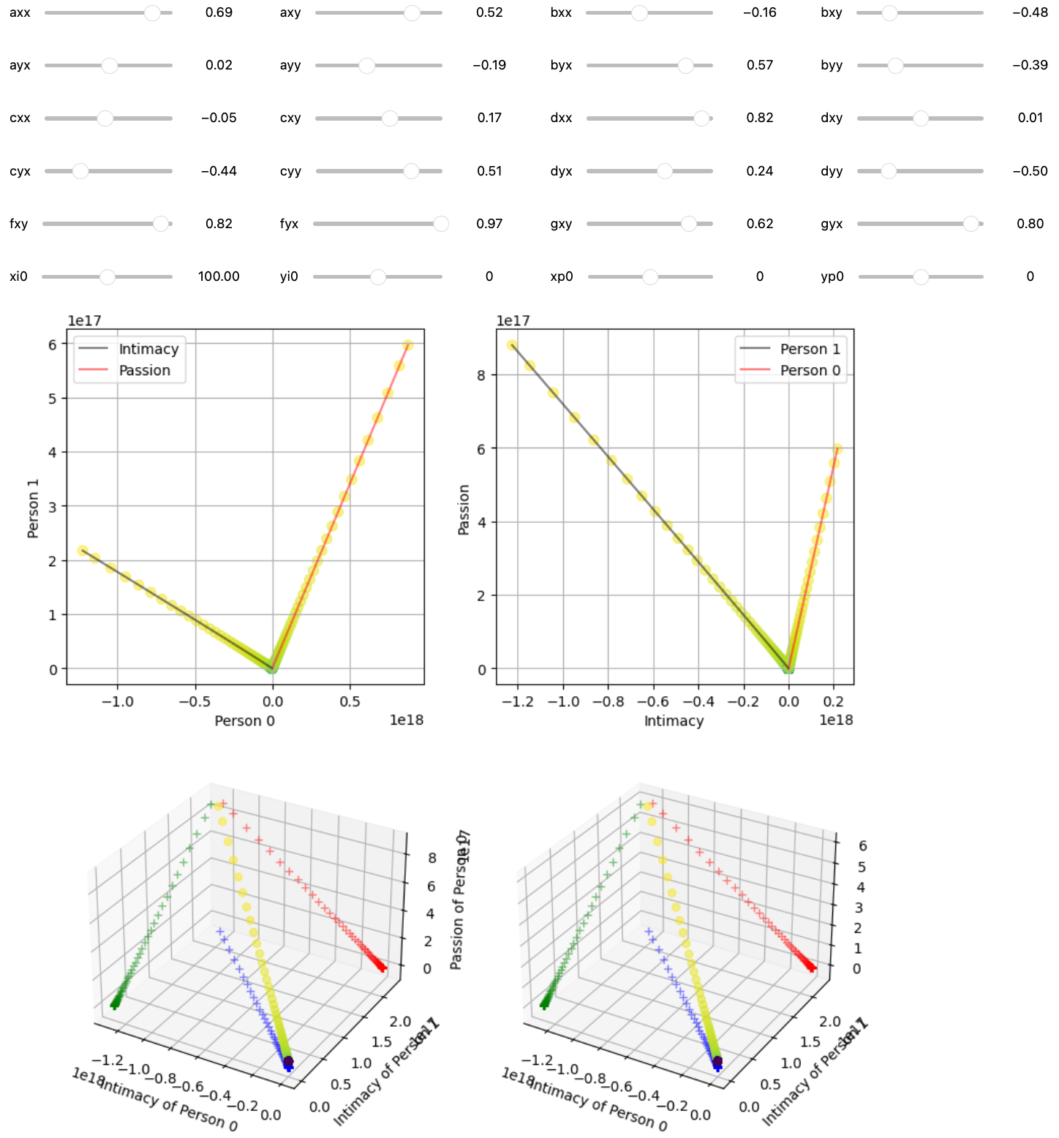
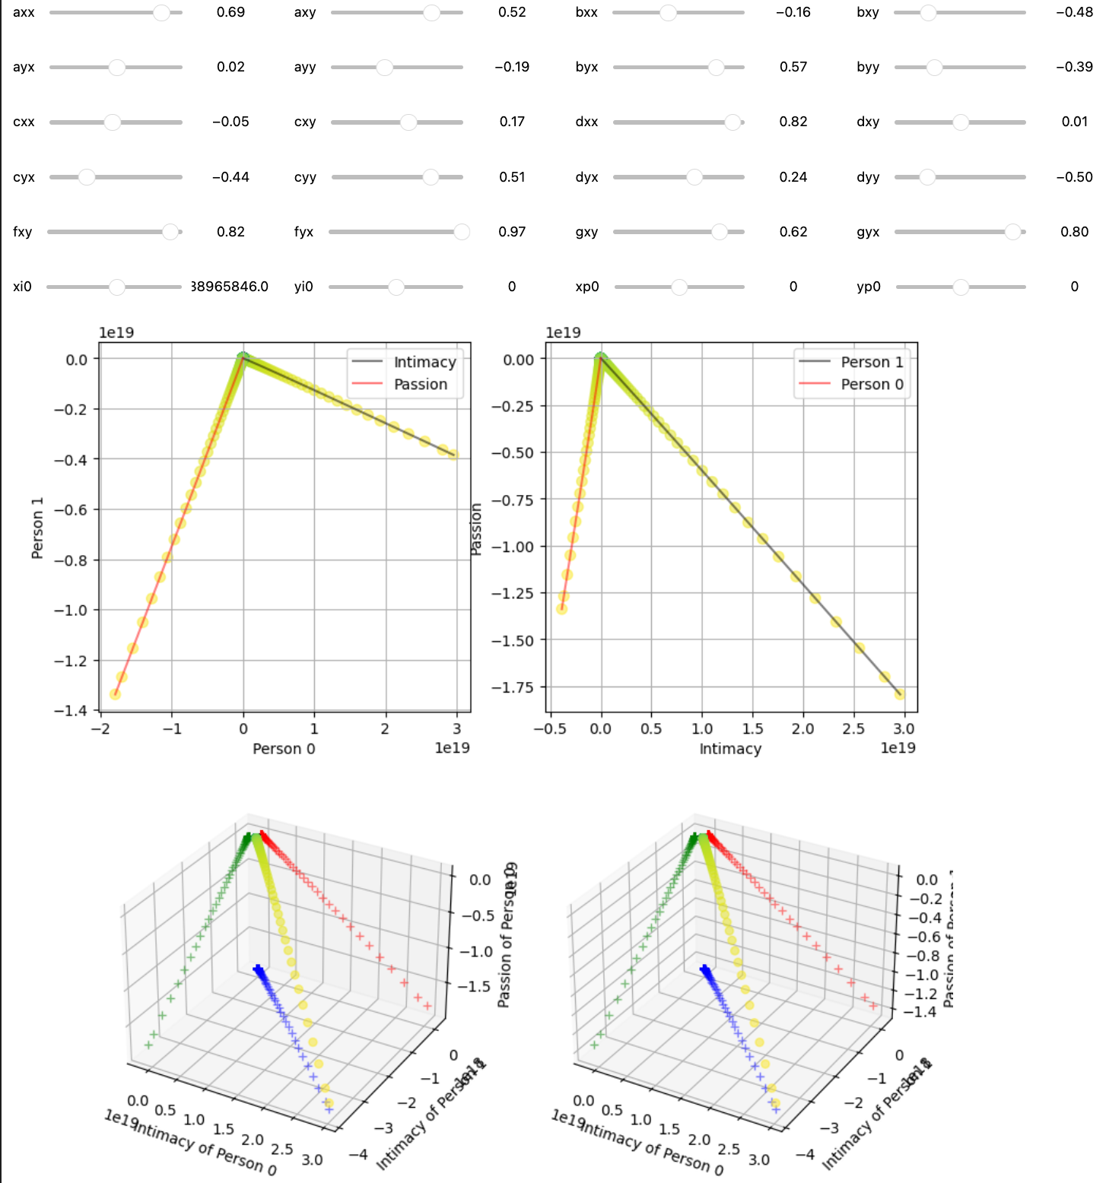
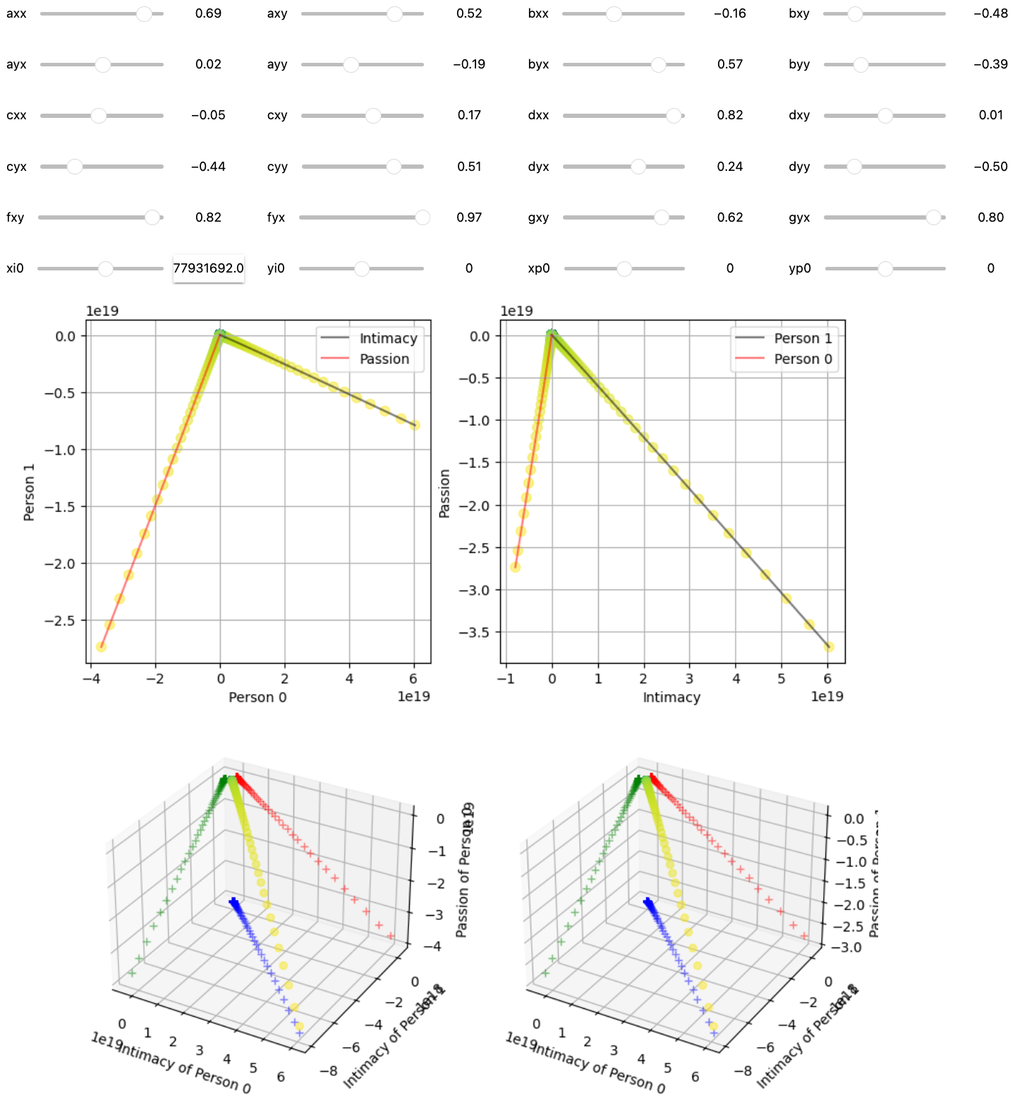
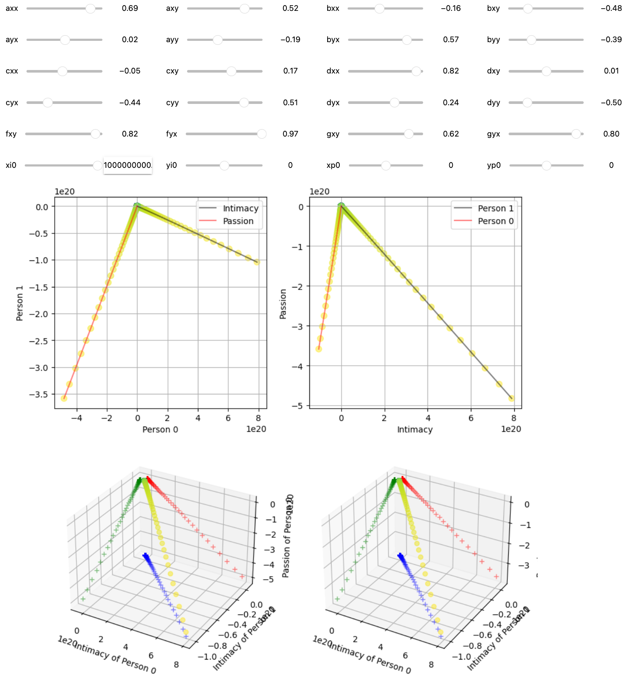
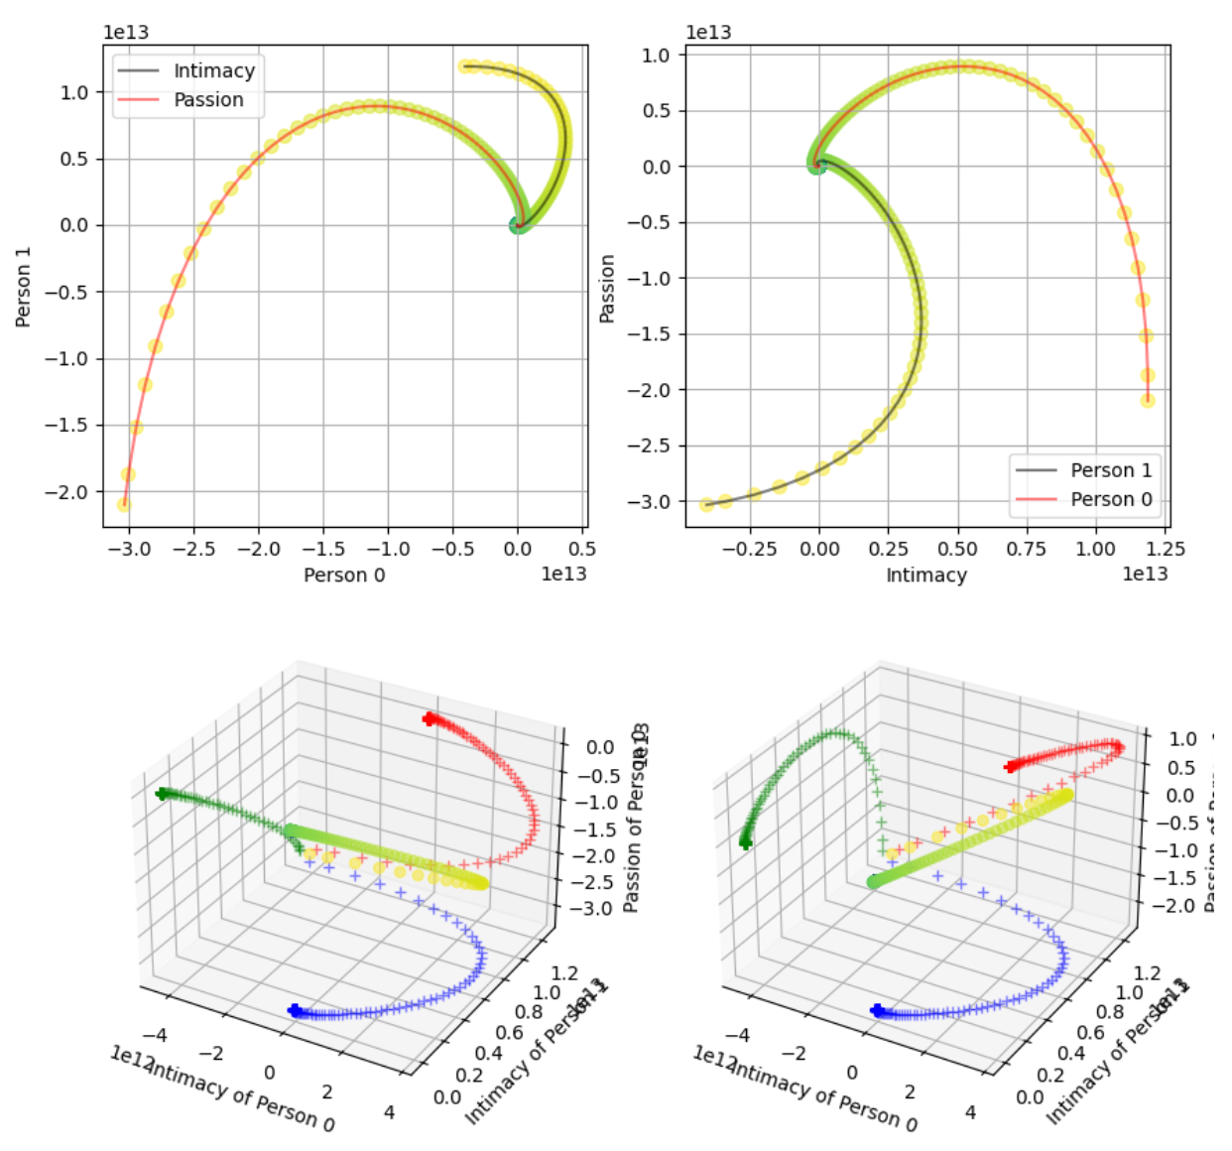
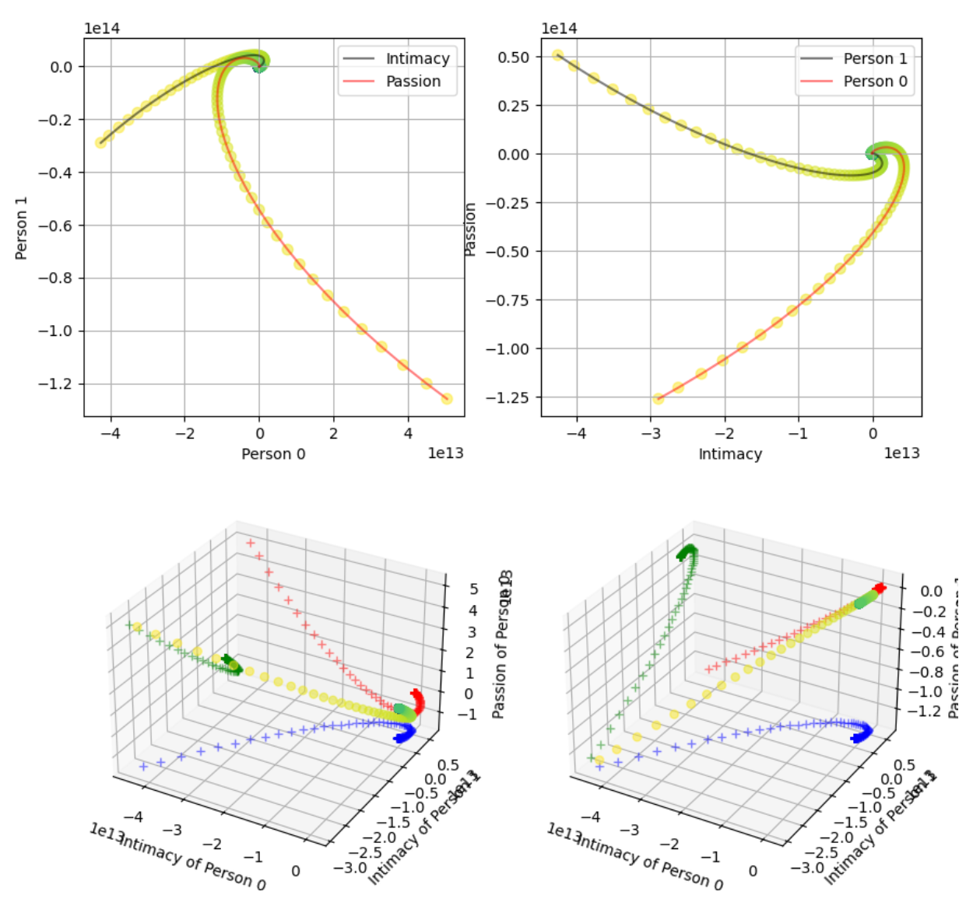
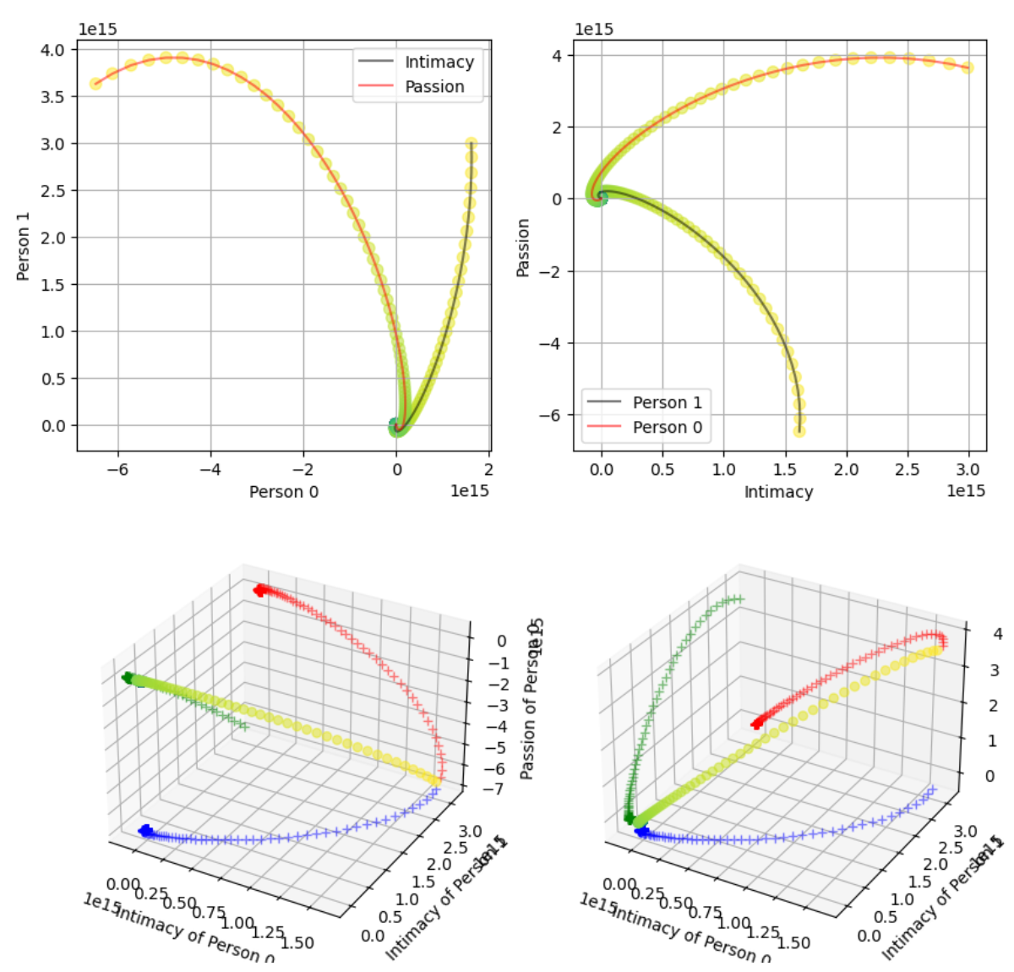
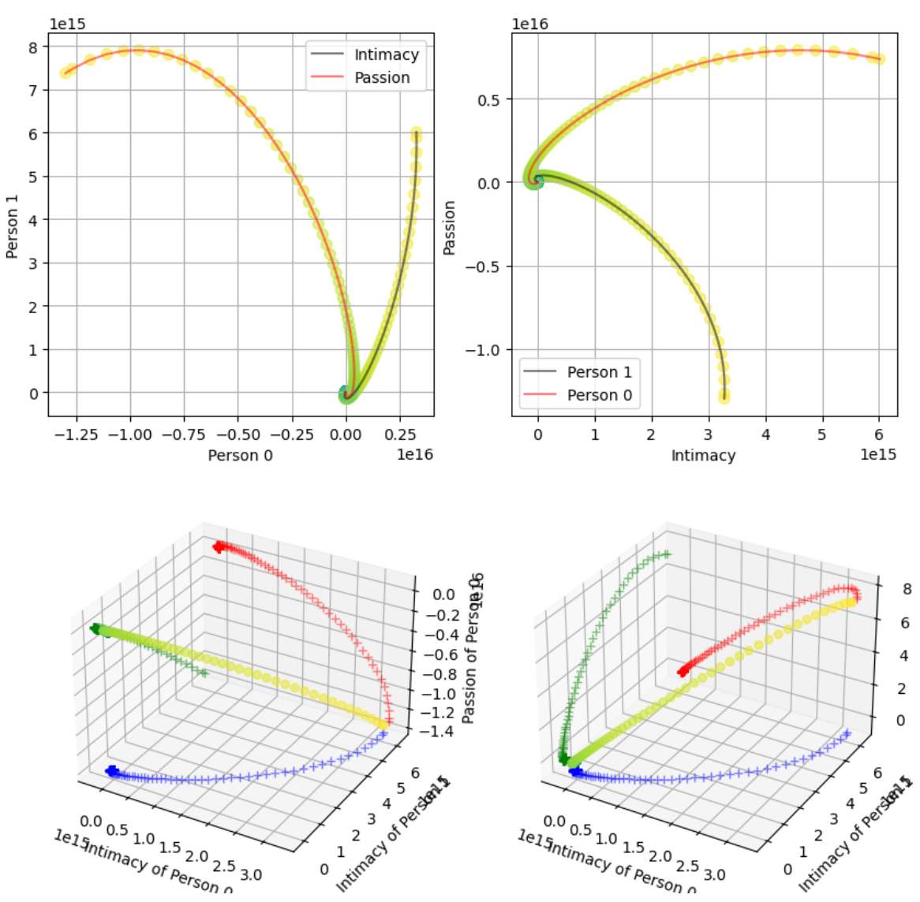
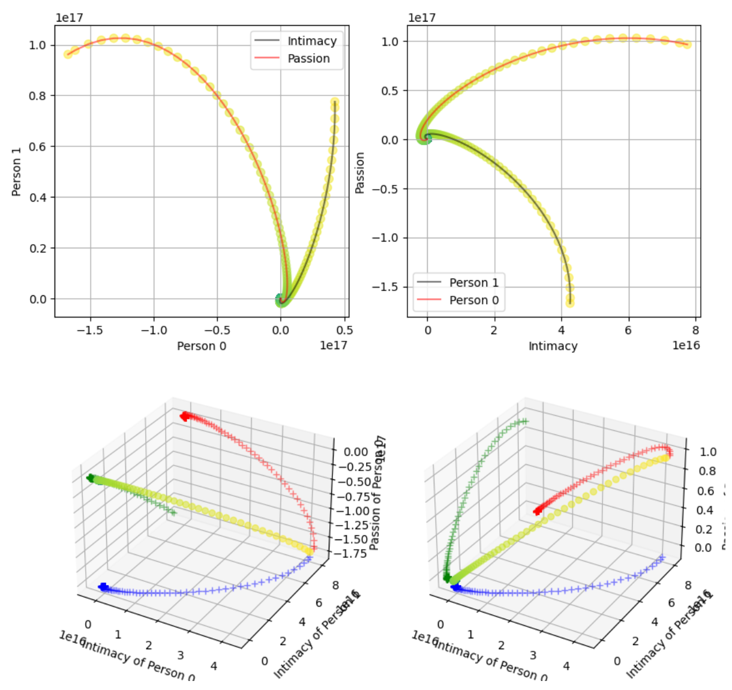
xi0 = 0
xi0 = 1000
xi0 = 38,965,846
xi0 = 77,931,691
xi0 = 1e9
In the grand scheme of things, 1e9 is small compared to the starting scale of 1e18
Even attempted with xi0 > 1,000,000, also negative numbers, changing all 4 initial values causes no significant change
yp0=0
yp0=1000
yp0=38,965,846
yp0=77,931,691
yp0 = 1e9
Notes:
Here you can see some chaos happening. I start out with 2 different types of graphs. A straight graph (that comes up frequently), and a "curvy" graph. I change the xi0 and yp0 values independently and plot the change in results.
Plotting the results do not show a significant change in graph structure. Some rotation, scaling, reflections, etc can be seen, but the general structure follows the same.
Not shown, but when ding the same but for negative numbers leads to similar results, just flipped around. Even randomly changing all 4 parameters does not lead to much of a change.

Slide 19
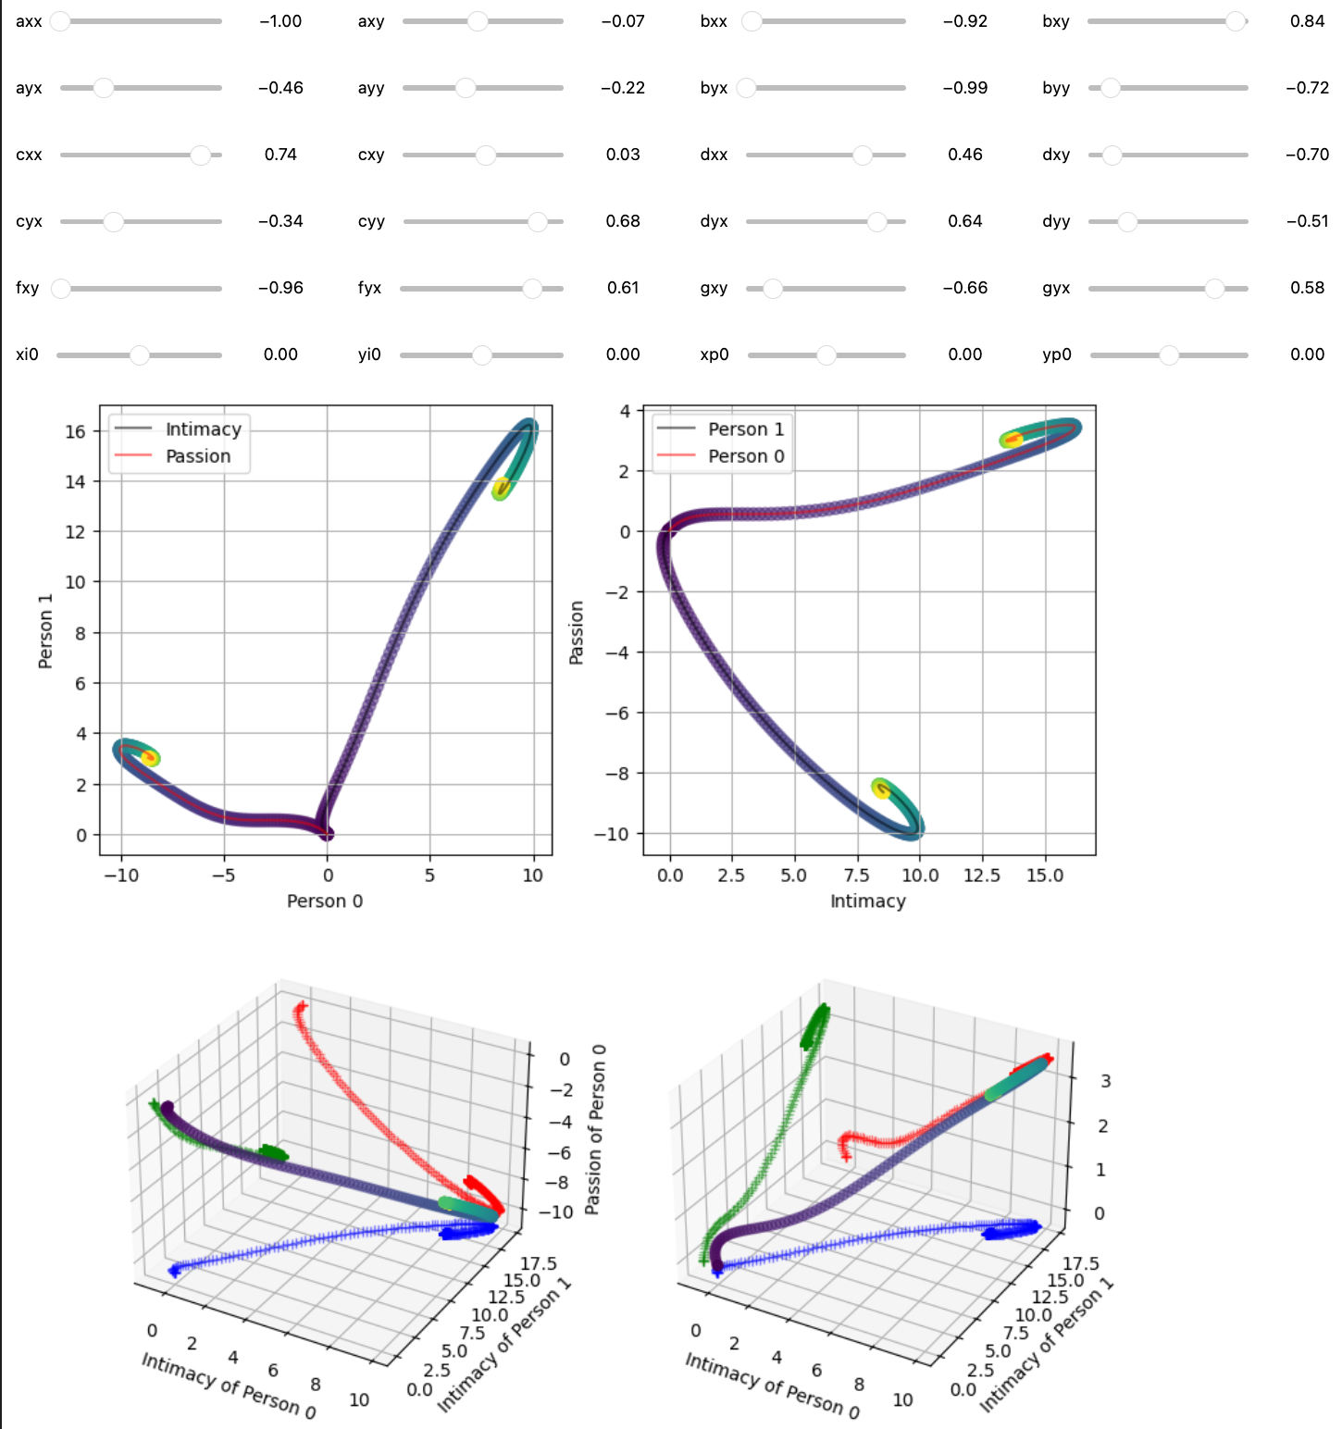
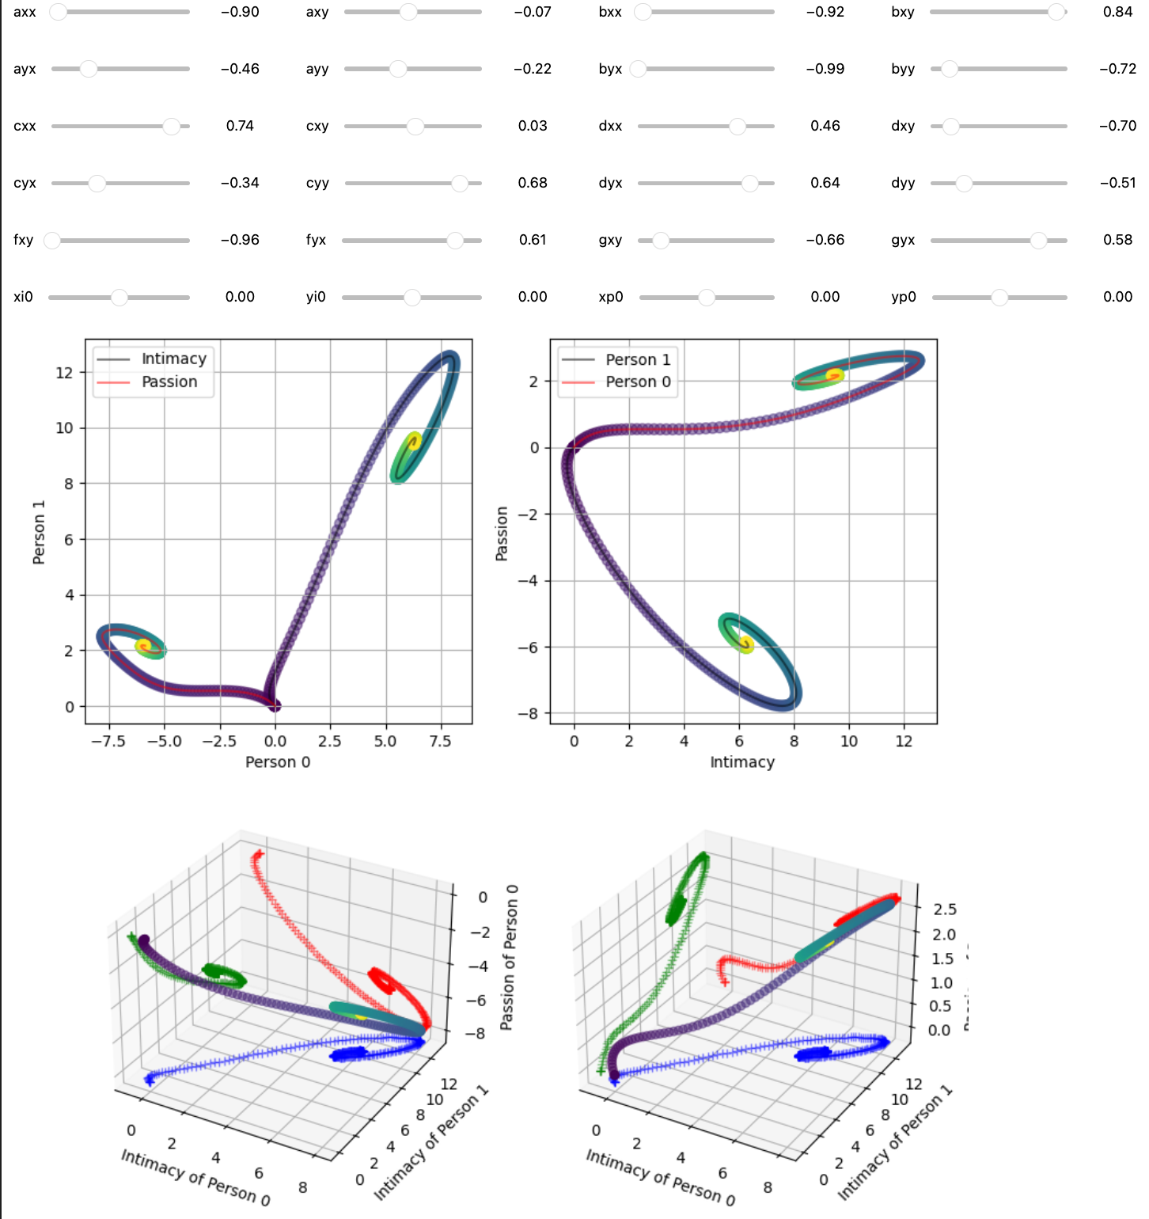
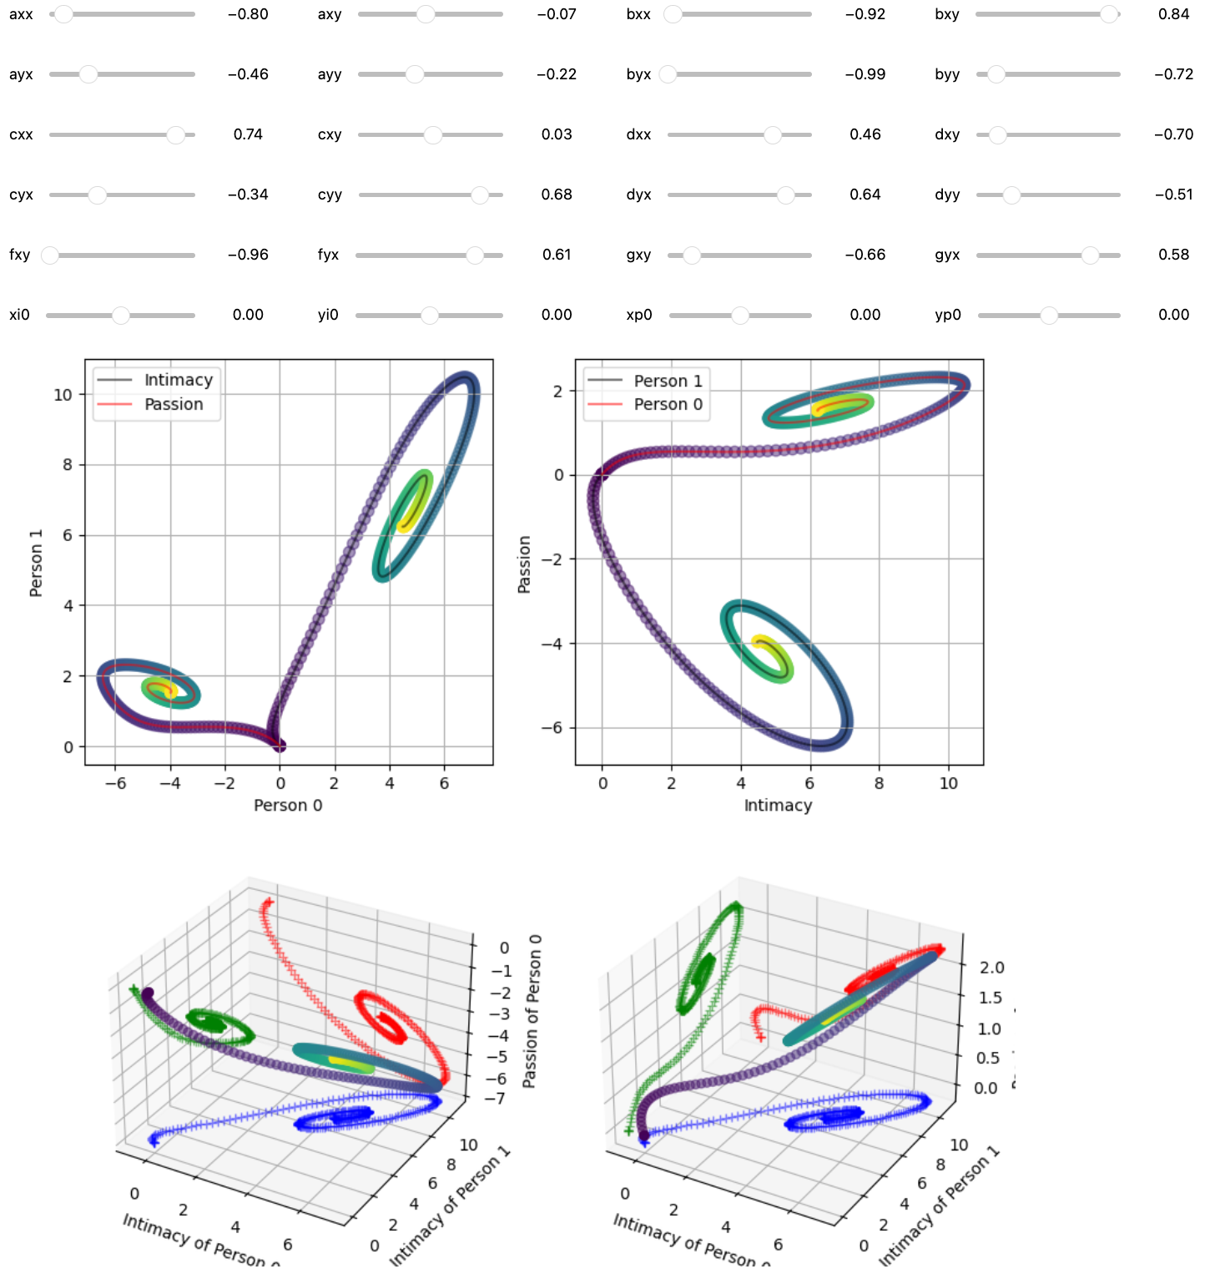
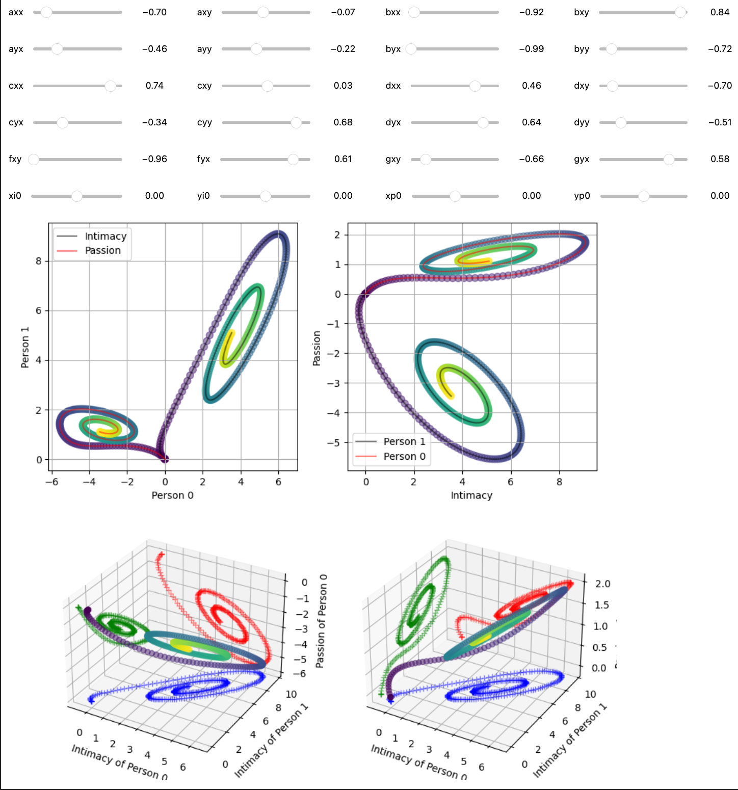
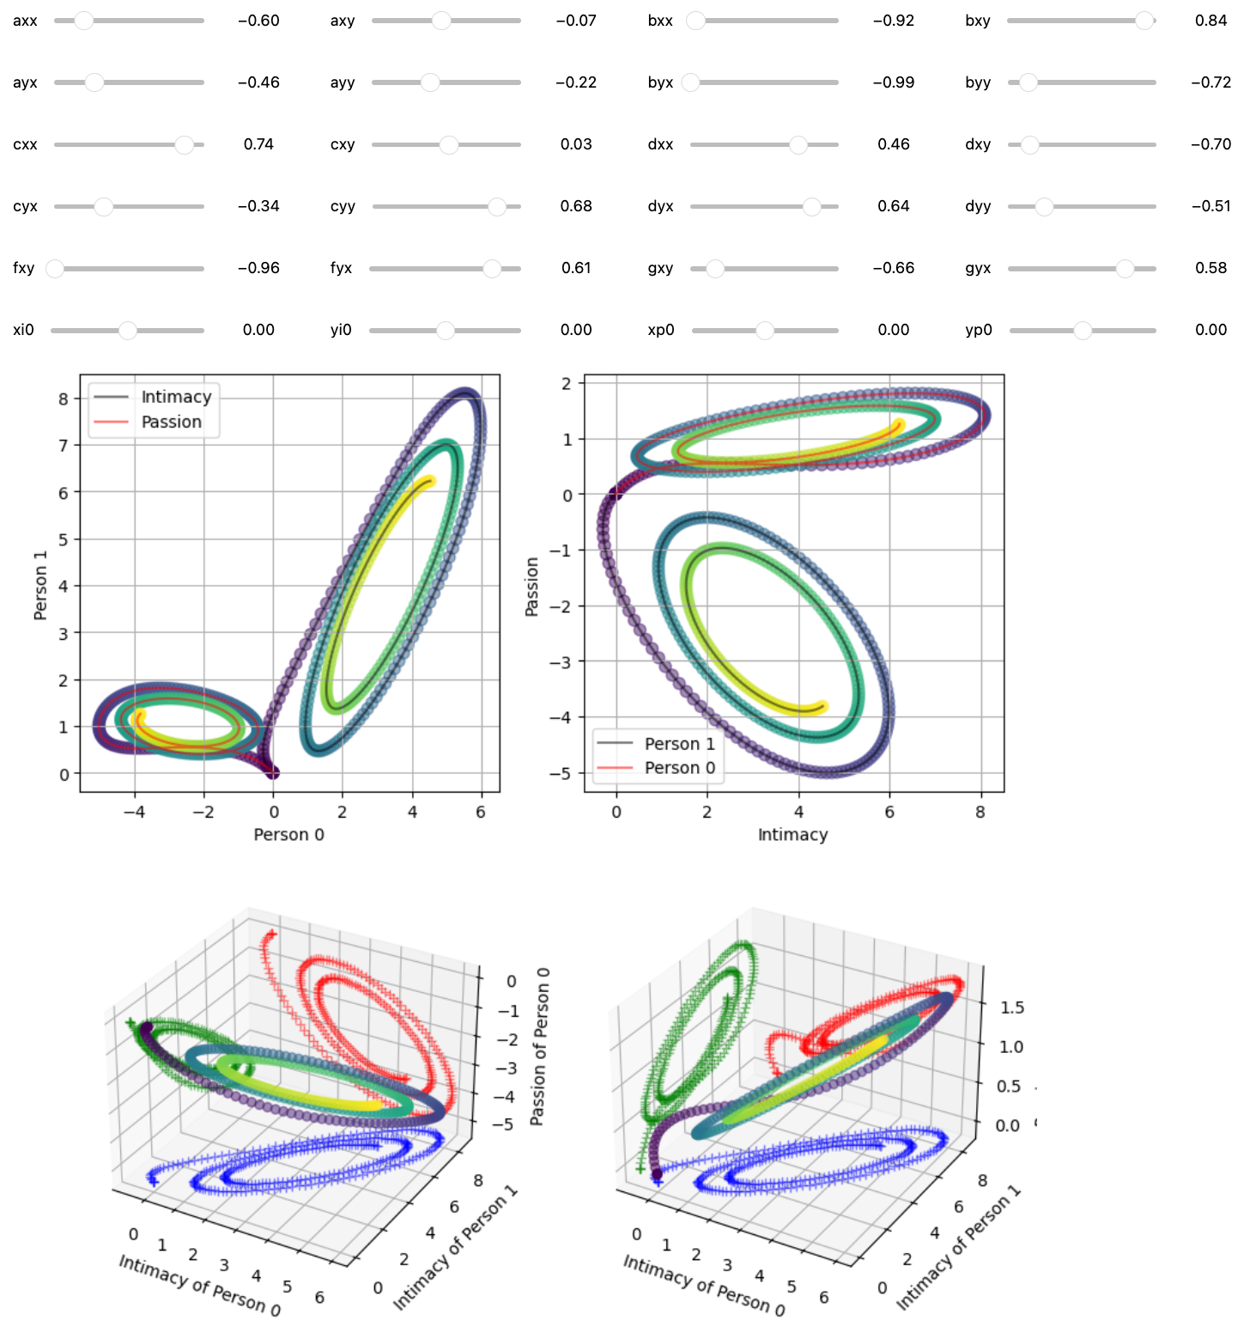
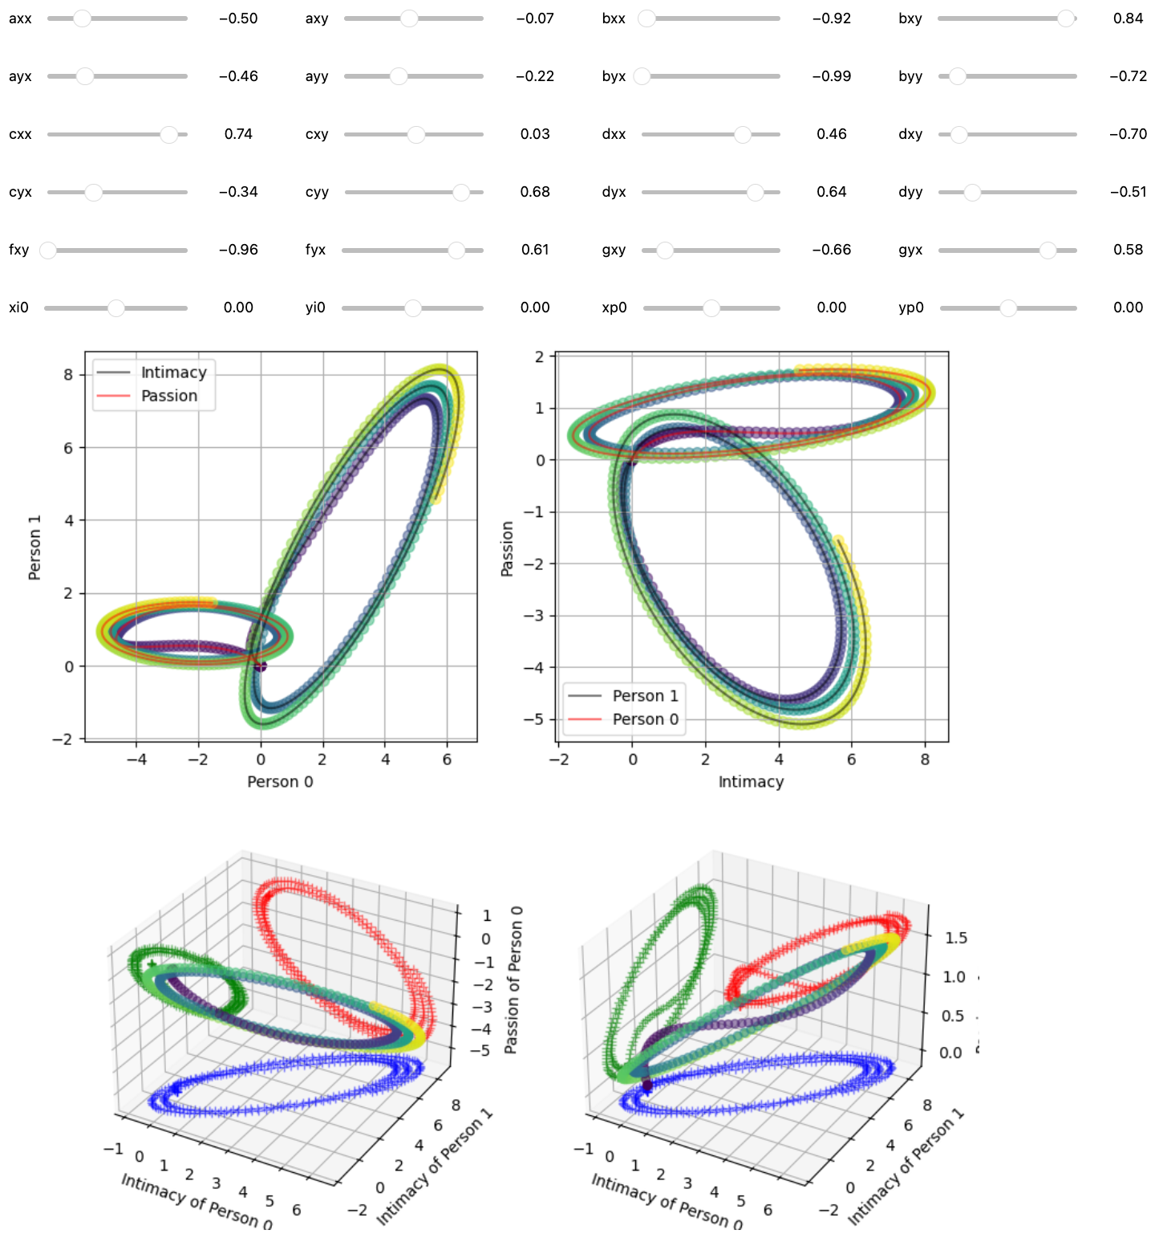
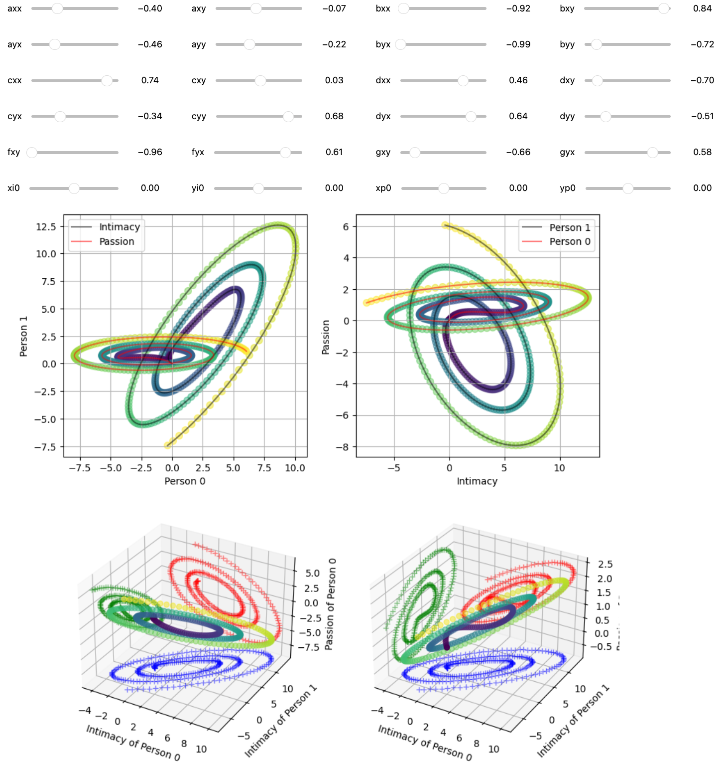
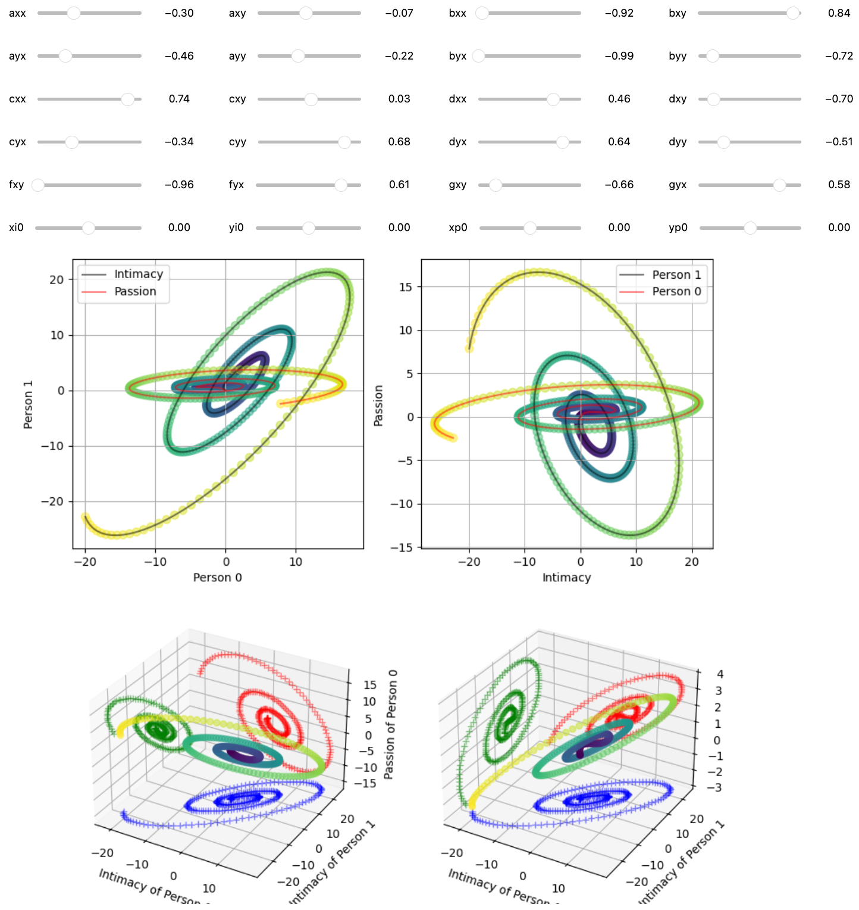
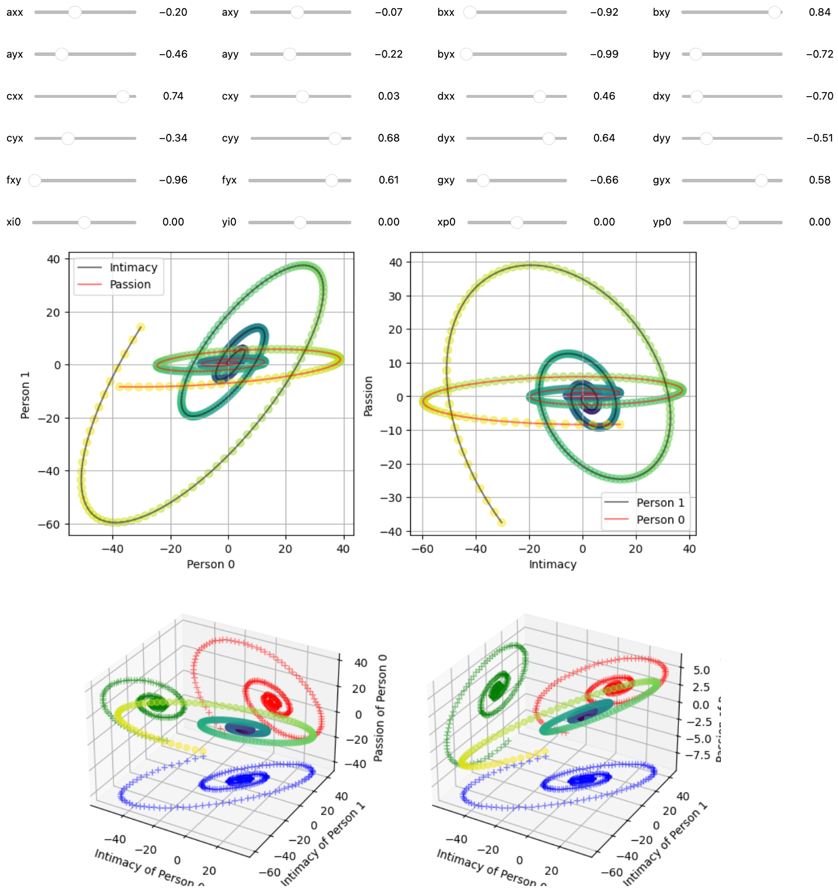
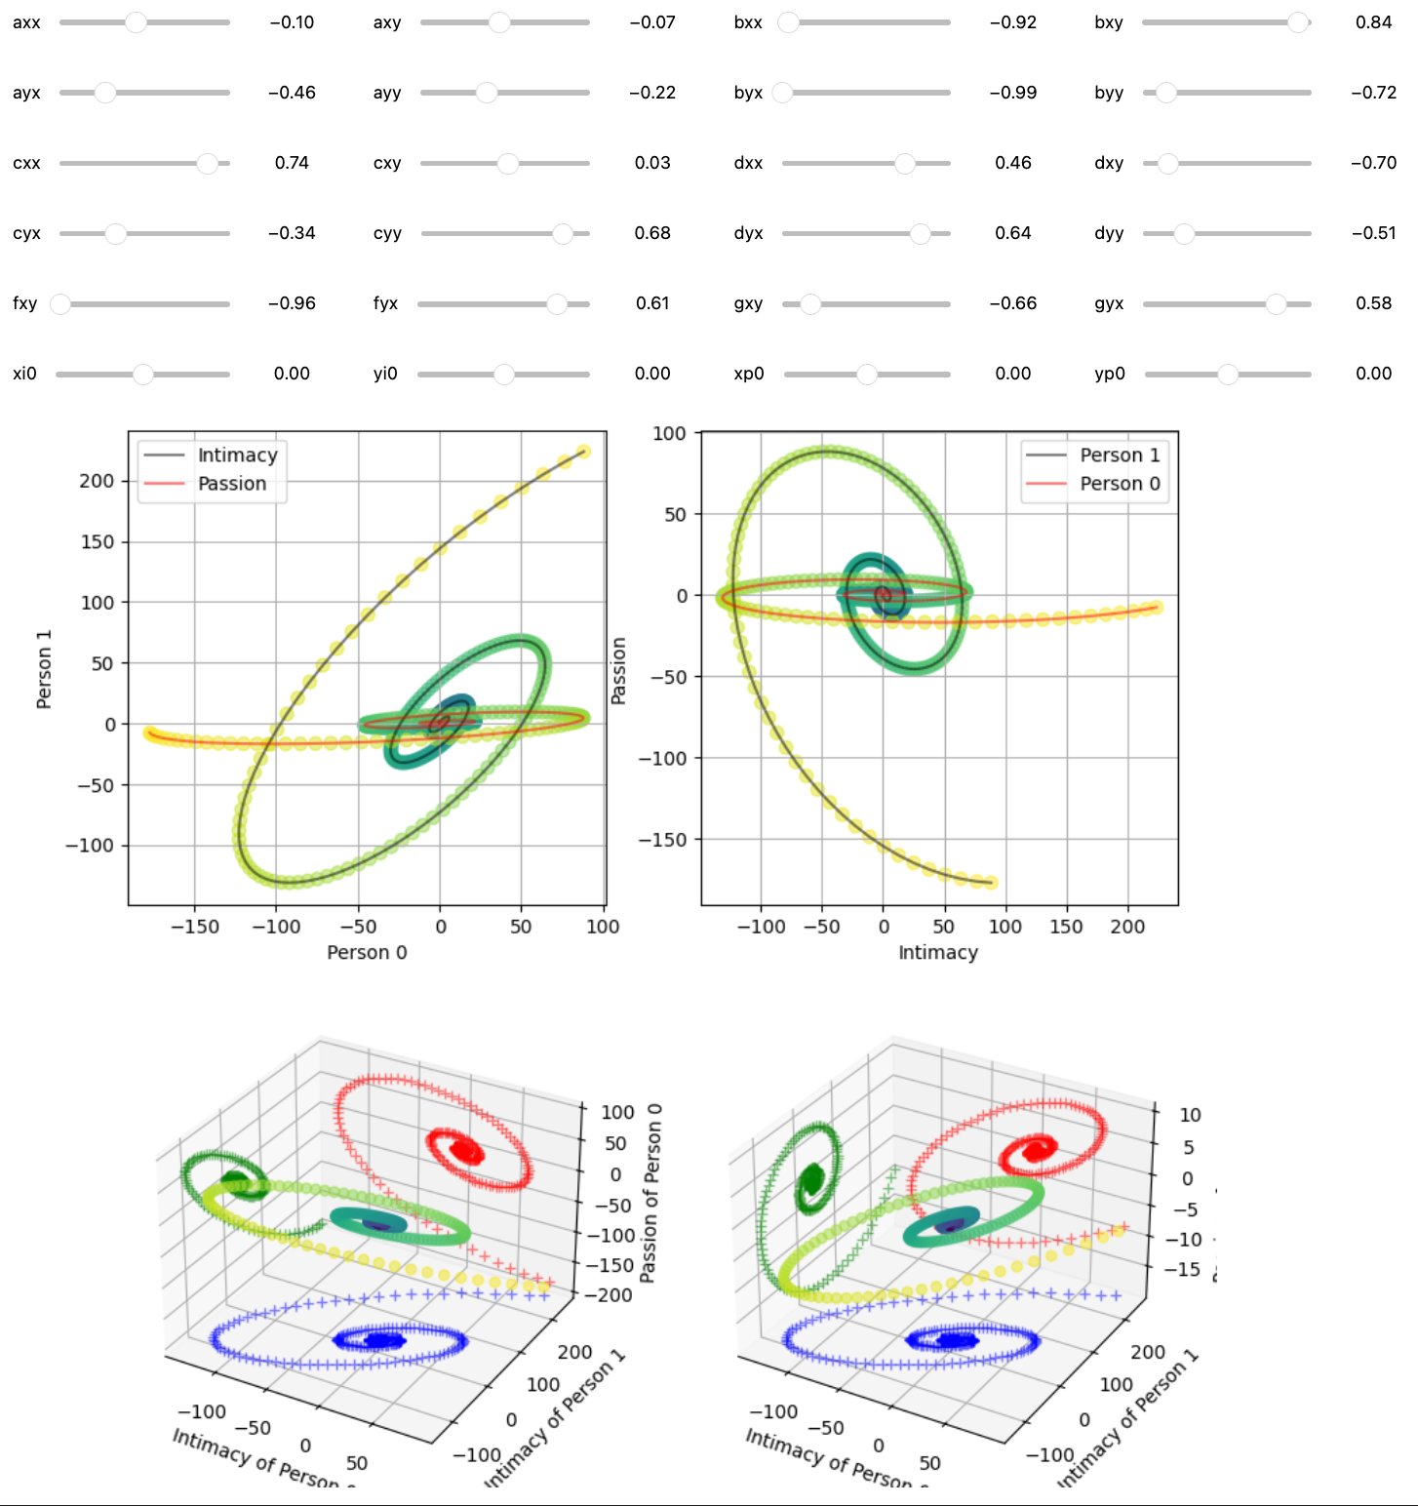











Change in axx from –1 to 1, stepsize = 0.1, not changing anything else
Notes:
The individual parameters of the function (axx for example) has a larger influence in the structure of the shape of the graphs than the starting initial condition.
The top right graphs remind me of the Lorenz Attractor Butterfly graph.
As such, the system is not chaotic persay, in the sense that a 2D pendulum is chaotic.
I decided to dive deeper in this paper and examine the plots more closely as the article was published in a chaos focused paper, however we do not see much chaos (drastic changes in the graph) with small and large changes in starting conditions as one would see in the double pendulum.

Slide 20








all params set to 0.1, change in graph as ayx = [1, 0.5, 0.1, -0.1,
-0.2, -0.4, -0.7, -1]
Notes:
To exemplify the "chaos" of the parameters and not initial condition, I changed ayx from 1 to 0.5, 0.1, … and plotted the results. You can see how as the values decrease the Passion (red arm) swings upwards, and intimacy (black arm) swings downwards. Once past ayx = –0.2, the system becomes chaotic, where you can see the different graphs. They still have the same general structure to it, but the shape becomes much more different than changing the initial parameters.
Reminds me of the ocean diagram that was shown in the lectures, where a wave started out small, grew bigger, crested, then became a total mess.
This is kinda like that. Straight lines then at the crest at ayx=-0.2 it start the transition towards the chaotic system/graph.

Slide 21



Program started from beginning with random parameters
axx=[0.69, -0.38, -1, 0.27, -0.11, -0.7]
bxx = [-0.16, 0.8, 0.74, 0.43, -0.68, 0.97]
Normalize params, sum=0,
axx =[0.17, -0.11, -0.27, 0.15, 0.20, 0.06, 0.03]
bxx = [0.00, 0.24, 0.22, 0.15, -0.13, 0.28]
axx=0.75, bxx=0.5, and renormalize, small change
axx=[0.57, -0.10, -0.24, 0.04, -0.04, -0.17]
bxx=[0.45, 0.21, 0.19, 0.12, -0.13, 0.24]
Notes:
And to demonstrate the network "evolving" with the normalizing feature (with all initial condition values set to 0)
Randomly set params, then normalize it with sum=0. Then change value of axx, bxx to 0.75 and 0.5 and renormalize to show how the parameters in the other graphs change as a result.
This feature helps demonstrate that also small changes in values doesn’t affect the system too much. It was also used to show how a big change in one parameter would result in a small change in the differences in the other sections of the network.

Slide 22








Notes:
Some pretty plots to demonstrate some different types of phenomena that can outcome. The parameters have a greater infleunce.

Slide 23
Final remarks: Shortcomings of the Models
Doesn’t account for individual differences:
sex differences,
Psychological differences,
Stochastic effects, etc
For the 4D system:
When normalizing the parameters, the simulation is "restarting" from the beginning
The system is linear, different model needed

